Slide 1

Software Development Best Practice Coding for Reproducible Research
Course Leader:
Course Helpers:
Sign in here
December 2024
https://tinyurl.com/8f9pwf4k

Slide 2
Code of Conduct
Our ethos is to provide a welcoming and supportive environment for all people, regardless of background or identity. By registering to attend this workshop, participants are agreeing to abide by the Researcher Development Code of Conduct.
Our goal is to support you to develop your programming skill sets to enable you to do cutting edge research. We want to create a positive and professional learning environment and therefore encourage the following kinds of behaviours:
Show courtesy and respect towards all who attend a workshop or engage in community events.
Be respectful of different viewpoints and experiences.
Gracefully accept constructive criticism.
Be patient if there are technical glitches. While we know something about how to use computers, we are not immune to internet or hardware issues.
Respect our policy on not recording workshops to protect the nature of the sessions and ensure we are GDPR compliant.
Notes:
Welcome Message:
"Welcome everyone! Our aim is to create a supportive and inclusive environment for all of you."
Code of Conduct:
"By attending, you’re agreeing to the Researcher Development Code of Conduct, which ensures mutual respect and professionalism."
Positive Behaviours:
"We encourage showing courtesy, respecting different viewpoints, and gracefully accepting constructive criticism."
Tech Glitches:
"Let’s be patient with any technical issues—we’ll work through them together."
Recording Policy:
"Please remember, workshops are not recorded to maintain privacy and comply with GDPR."

Slide 3
Programme Funding
The CfRR training programme is supported by:
Research Software Analytics Group
Institute for Data Science and Artificial Intelligence (IDSAI)
University of Exeter Reproducibility Leadership Team
EPSRC Research Software Engineering Fellowship
Community of academics who volunteer their time to support delivery
To make the case for continued investment, please help us demonstrate the impact of these sessions by attending all courses you register for and providing feedback at the end of the course.
Notes:
Acknowledging Support:
"This training program is made possible by support from several groups, including the Research Software Analytics Group, IDSAI, the University of Exeter Reproducibility Leadership Team, and the EPSRC RSE Fellowship."
Community Contribution:
"A big thank you to the academics who volunteer their time to help deliver these sessions."
Continued Investment:
"Your attendance and feedback are essential for making the case for ongoing funding, so please help us by completing the course and sharing your thoughts at the end."

Slide 4

Course Objectives
On completion of this course, we will:
have a high-level understanding of software development for research.
be able to collaborate on code effectively.
be able to improve the reproducibility of our research by understanding how to make our code useful to others.
have the necessary foundations for intermediate level courses that will delve deeper into software development topics.
Notes:
Overview:
"By the end of this course, you'll have a solid understanding of software development tailored for research."
Collaboration:
"You'll learn how to collaborate on code effectively, a crucial skill for team-based research."
Reproducibility:
"We'll focus on improving reproducibility by making your code accessible and useful to others."
Next Steps:
"This course provides the foundations for more advanced topics in future sessions."

Slide 5
Session Topics
Today:
Software Development Life Cycle & Methodologies
Data Management
Problem Solving
Virtual Environments & Dependency Managers
Next Week:
Version Control
Readable Code & Documentation
Testing
Collaboration & Reproducibility
Notes:
Today’s Focus:
"Today, we'll cover foundational topics, starting with the Software Development Life Cycle and Methodologies, followed by Data Management, Problem Solving, and Virtual Environments with Dependency Managers."
Next Week’s Topics:
"Next week, we'll dive deeper into practical skills like Version Control, Readable Code, Documentation, Testing, and Collaboration for Reproducibility."
Building Knowledge:
"The sessions are designed to build on each other, giving you the tools and techniques to improve your research workflows step by step."

Slide 6
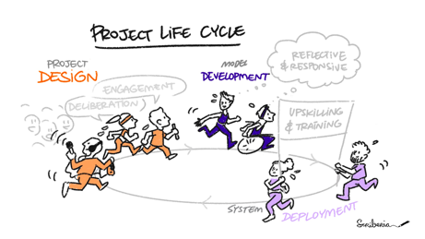
Episode 1: Software Development Life Cycle & Methodologies
This image was created by Scriberia for The Turing Way community and is used under CC-BY licence. http://doi.org/10.5281/zenodo.4906004
Notes:
Introduction:
"Let’s start with an overview of the Software Development Life Cycle and the methodologies that guide how we plan and implement software projects."
Importance:
"Understanding these concepts is essential for structuring research software development and improving efficiency and collaboration."
What to Expect:
"We’ll explore the phases of the life cycle, compare methodologies like Waterfall and Agile, and discuss how they can be applied in research contexts."

Slide 7
Software Development Life Cycle
Notes:
Let’s dive into the Software Development Life Cycle—a structured process that guides how we plan, create, and maintain software, ensuring it meets user needs and adapts to change over time."

Slide 8
Software Development Life Cycle
Requirements Gathering
Notes:
Requirements Gathering:
"The first step is understanding what the software needs to achieve. This includes gathering input from stakeholders and defining clear functional and non-functional requirements."

Slide 9
Software Development Life Cycle
Requirements Gathering
Design
Notes:
Design:
"Next, we plan the structure of the software. This involves creating system architectures, data models, and planning interactions between components."

Slide 10
Software Development Life Cycle
Requirements Gathering
Design
Implementation
Notes:
Implementation:
"Here, we actually write the code based on the design, making the planned functionality a reality."

Slide 11
Software Development Life Cycle
Requirements Gathering
Design
Implementation
Testing
Notes:
Testing:
"Testing ensures the software works as expected, catching bugs and validating it meets the requirements."

Slide 12
Software Development Life Cycle
Requirements Gathering
Design
Deployment
Implementation
Testing
Notes:
Deployment:
"Once the software is ready, it’s deployed for use in a production environment or shared with users."

Slide 13
Software Development Life Cycle
Requirements Gathering
Maintenance
Design
Deployment
Implementation
Testing
Notes:
Maintenance:
"Finally, software requires ongoing maintenance to fix issues, adapt to changing needs, or add new features."
Wrap-Up:
"This cycle is iterative—feedback from later stages often informs earlier steps, helping refine and improve the software over time."

Slide 14
Software Development Life Cycle
What are the benefits?
Development becomes more predictable.
The outcome of each phase can be reviewed before moving onto the next.
It can save time.
Notes:
Predictability:
"Following a structured cycle makes the development process more predictable, helping teams plan and manage resources effectively."
Review and Validation:
"Each phase provides an opportunity to review progress and ensure everything aligns with the goals before moving forward."
Time Savings:
"Although it may seem time-consuming upfront, this approach can save time in the long run by reducing errors and rework."

Slide 15
Software Development Methodologies
Waterfall vs Agile
Notes:
Waterfall:
"Waterfall is a linear, sequential approach where each phase—like design, implementation, and testing—is completed before moving on to the next."
"It’s predictable and works well for projects with clear, fixed requirements but can struggle with changes mid-project."
Agile:
"Agile is an iterative, flexible approach that focuses on small, incremental deliverables and continuous feedback."
"It’s ideal for projects where requirements may evolve or where collaboration with stakeholders is critical."
Comparison:
"Waterfall offers structure and predictability, while Agile thrives in dynamic environments, making it particularly valuable for research projects with uncertainty."
Context Matters:
"The choice between the two often depends on the project's nature—some research projects may even benefit from a hybrid approach."

Slide 16
Software Development Methodologies
Manifesto for Agile Software Development
We are uncovering better ways of developing software by doing it and helping others to do it.
Through this we have come to value:
Individuals and interactions over processes and tools
Working software over comprehensive documentation
Customer collaboration over contract negotiation
Responding to change over following a plan
That is, while there is value in the items on the right, we value the items on the left more.
Notes:
Purpose of the Manifesto:
"The Agile Manifesto emphasizes a flexible, people-focused approach to software development, which has become the foundation for modern iterative methodologies."
Core Values:
"It highlights four key values: prioritizing individuals and interactions, working software, collaboration, and adaptability over rigid processes, documentation, and plans."
Balance:
"While the items on the right are still important, the emphasis is on the left, allowing teams to focus on delivering functional, user-centered solutions."
Relevance to Research:
"This approach is particularly useful in research projects, where uncertainty and evolving requirements are common, making adaptability and collaboration essential."

Slide 17
Software Development Methodologies - Agile
Testing
Implementation
(review progress &
reflect on requirements)
Requirements Gathering
Design
Deployment
Maintenance
Notes:
Iterative Process:
"Agile follows an iterative process where progress is reviewed regularly, allowing for continuous improvement and adapting to changing requirements."
Feedback Loops:
"Testing and reflecting on requirements happen throughout the cycle, ensuring the product evolves based on feedback."
Flexibility:
"Unlike Waterfall, Agile embraces flexibility, making it easier to handle the dynamic and uncertain nature of research projects."
Collaborative Approach:
"It encourages collaboration and open communication between team members and stakeholders, which is crucial in multidisciplinary research."
Benefits for Research:
"This approach helps researchers avoid wasted effort by frequently checking alignment with project goals and adapting as needed."

Slide 18
Software Development Methodologies - Agile

Slide 19
Software Development Methodologies - Agile
Daily Standup
Notes:
Daily Standup:
"Short, focused meetings where the team shares progress, plans, and roadblocks to maintain alignment."

Slide 20
Software Development Methodologies - Agile
Daily Standup
Sprint Planning Meetings
Notes:
Sprint Planning Meetings:
"Collaborative sessions to plan the next sprint, deciding what work will be tackled and how."

Slide 21
Software Development Methodologies - Agile
Daily Standup
Sprint Planning Meetings
Show & Tell
Notes:
Show & Tell:
"Opportunities to demonstrate progress and gather feedback, keeping stakeholders engaged."

Slide 22
Software Development Methodologies - Agile
Daily Standup
Sprint Planning Meetings
Show & Tell
Retrospective Meetings
Notes:
Retrospective Meetings:
"After each sprint, the team reflects on what went well, what didn’t, and how to improve."

Slide 23
Software Development Methodologies - Agile
Daily Standup
Sprint Planning Meetings
Show & Tell
Retrospective Meetings
User Stories
Notes:
User Stories:
"Descriptions of desired functionality from the user’s perspective, ensuring clarity and focus on needs."

Slide 24
Software Development Methodologies - Agile
Daily Standup
Sprint Planning Meetings
Show & Tell
Retrospective Meetings
User Stories
Backlog
Notes:
Backlog:
"A prioritized list of tasks or features that guides the team’s work."

Slide 25
Software Development Methodologies - Agile
Daily Standup
Sprint Planning Meetings
Show & Tell
Retrospective Meetings
User Stories
Backlog
Team Walls
Notes:
Team Walls:
"Visual boards (physical or digital) to track tasks, making the workflow visible to everyone."
Wrap-Up:
"These Agile practices are designed to foster collaboration, adaptability, and continuous improvement, which are especially useful in research contexts where goals and requirements can change rapidly."

Slide 26
Activity: Reflection/Discussion
How can the software development life cycle and methodologies, including the tools and techniques, introduced be applied within a research context?
What could prove beneficial in a research context?
What could prove difficult in a research context?
How might our current processes need to change?
Notes:
Now that we’ve explored the software development life cycle and methodologies, let’s reflect on how these can be integrated into research workflows. Research contexts often have unique challenges, but adopting structured development practices can offer significant benefits
Question 1: What could prove beneficial in a research context?
Prompt ideas such as:
• Improved reproducibility.
• Better collaboration, especially in interdisciplinary teams.
• Clearer goals and milestones.
• Easier onboarding of new team members.
• Encourage specific examples, e.g., “How might Agile practices like sprints or stand-ups help in your projects?”
Question 2: What could prove difficult in a research context?
Highlight common challenges:
• Resistance to adopting formal methodologies due to time pressures or lack of awareness.
• Adapting methods like Agile to projects with uncertain or evolving goals.
• Balancing coding with other research responsibilities.
• Ask participants for their perspectives, e.g., “Have you faced resistance when suggesting changes in your workflow?”
Question 3: How might our current processes need to change?
Focus on practical changes:
• Introducing version control for better collaboration.
• Allocating time for planning and documentation.
• Using tools like project management software or task boards.
• Ask: “What small changes could you start with to improve your workflows?”
It seems many of you see benefits in adopting these methodologies, like clearer goals and better collaboration, but challenges such as time constraints and adapting to research workflows remain. Starting with small, manageable changes could be a good way forward

Slide 27
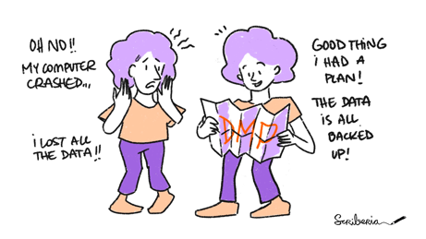
Episode 2: Data Management
This image was created by Scriberia for The Turing Way community and is used under CC-BY licence. http://doi.org/10.5281/zenodo.4906004

Slide 28
Data Management – Life Cycle
Plan
Share
Acquire
Preserve
Process
Analyse

Slide 29
Data Management – Life Cycle
Before
Plan
Share
Acquire
Preserve
Process
Analyse
Notes:
Plan:
"Start by planning how your data will be collected, organized, and managed. This ensures efficiency and prevents issues down the line."

Slide 30
Data Management – Life Cycle
Plan
During
Share
Acquire
Preserve
Process
Analyse
Notes:
Acquire:
"The process of gathering data through experiments, observations, or other methods."
Process:
"Transform raw data into a usable format by cleaning, organizing, or standardizing it."
Analyse:
"Examine the processed data to extract meaningful insights and generate results."

Slide 31
Data Management – Life Cycle
After
Plan
Share
Acquire
Preserve
Process
Analyse
Notes:
Preserve:
"Preserve your data for future use by archiving it in a secure and accessible format."
Share:
"Sharing your data with others promotes reproducibility, collaboration, and scientific progress."
Wrap-Up:
"The Data Management Life Cycle is essential for ensuring that data remains accessible, understandable, and useful throughout and beyond the project."

Slide 32
Data Management – Plan
A Data Management Plan (DMP)…
describes how data will be acquired, managed, preserved and shared in an efficient and secure manner.
should also describe any potential legal or ethical issues that need to be addressed.
is a living document that can be updated during the project as needed.
What are the benefits?
It can allow us to save time later, as well as prevent data loss or breaches.
It makes it easier to share data, promoting the FAIR principles.
Notes:
What is a Data Management Plan (DMP)?
"A DMP outlines how data will be acquired, managed, preserved, and shared securely and efficiently throughout the project."
"It also addresses legal or ethical considerations, ensuring compliance with regulations."
Living Document:
"A DMP isn’t static—it evolves as the project progresses, adapting to new challenges and requirements."
Benefits of a DMP:
"It saves time later by streamlining data workflows and preventing issues like data loss or breaches."

Slide 33
Data Management – Plan
A Data Management Plan (DMP)…
describes how data will be acquired, managed, preserved and shared in an efficient and secure manner.
should also describe any potential legal or ethical issues that need to be addressed.
is a living document that can be updated during the project as needed.
What are the benefits?
It can allow us to save time later, as well as prevent data loss or breaches.
It makes it easier to share data, promoting the FAIR principles.
Findability
Accessibility
Interoperability
Reusability
Notes:
"It simplifies data sharing, supporting FAIR principles—making data Findable, Accessible, Interoperable, and Reusable."
Relevance to Research:
"A well-thought-out DMP is key to ensuring your research is organized, secure, and easily reproducible."

Slide 34
Data Management – Plan
DMPonline
Research Data Management Team
Research Ethics and Governance Team
A Data Management Plan (DMP)…
describes how data will be acquired, managed, preserved and shared in an efficient and secure manner.
should also describe any potential legal or ethical issues that need to be addressed.
is a living document that can be updated during the project as needed.
What are the benefits?
It can allow us to save time later, as well as prevent data loss or breaches.
It makes it easier to share data, promoting the FAIR principles.
Notes:
DMPonline:
"DMPonline is a tool that helps you create comprehensive Data Management Plans tailored to your project’s needs and funder requirements."
Research Data Management Team:
"The Research Data Management Team offers guidance and support for managing your data effectively throughout your research."
Research Ethics and Governance Team:
"This team can help navigate ethical and legal considerations, ensuring your research complies with relevant regulations and standards."
Wrap-Up:
"These resources are invaluable for creating and maintaining effective data management practices, so make sure to explore them for additional support."

Slide 35
Data Management – Acquire, Process & Analyse
Logical file structure
Meaningful file names
Version control
Secure data storage
Portable storage devices
Backup strategy
Documentation
Metadata
Every individual working with the data is responsible for it.
Notes:
Logical Organization:
"Organize files with a clear, logical structure and use meaningful file names to make data easy to find and understand."
Version Control:
"Version control ensures you can track changes to your data and revert to earlier versions if needed."
Secure Data Storage:
"Store data securely, whether on portable devices or in the cloud, and implement a robust backup strategy to prevent data loss."
Documentation and Metadata:
"Document your data clearly and use metadata to describe its context, making it easier for others (and your future self) to use."
Shared Responsibility:
"Remember, everyone working with the data shares responsibility for its proper management."
Wrap-Up:
"By focusing on these principles, you can ensure your data is not only well-managed but also secure, accessible, and ready for analysis."

Slide 36
Data Management – Preserve & Share
What are the benefits of sharing our data?
Enable others to fully reproduce our study
Prevent duplicate efforts and speed up scientific progress
Increase the impact and quality of our research
Facilitate collaboration
How can we share our data?
Decide what data should be shared to enable others to reproduce our research.
Choose a data repository or sharing platform.
Choose a licence and link our research outputs.
Upload our data and documentation.
Good data management habits are essential for creating data suitable for sharing.
Notes:
Benefits of Sharing Data:
"Sharing data enables others to fully reproduce your study, ensuring transparency and credibility."
"It prevents duplication of effort, speeding up scientific progress and resource efficiency."
"Shared data can increase the impact and quality of your research by making it more widely accessible."
"It also facilitates collaboration, opening opportunities for new partnerships and insights."
How to Share Data:
"First, decide what data is essential for others to reproduce your research—focus on clarity and relevance."
"Select a trusted data repository or platform for sharing."
"Choose an appropriate license to clarify how your data can be used and link it to your research outputs."
"Finally, upload both your data and accompanying documentation to ensure others can understand and use it effectively."
Wrap-Up:
"Preserving and sharing data is crucial for advancing research, ensuring reproducibility, and fostering collaboration across disciplines."

Slide 37
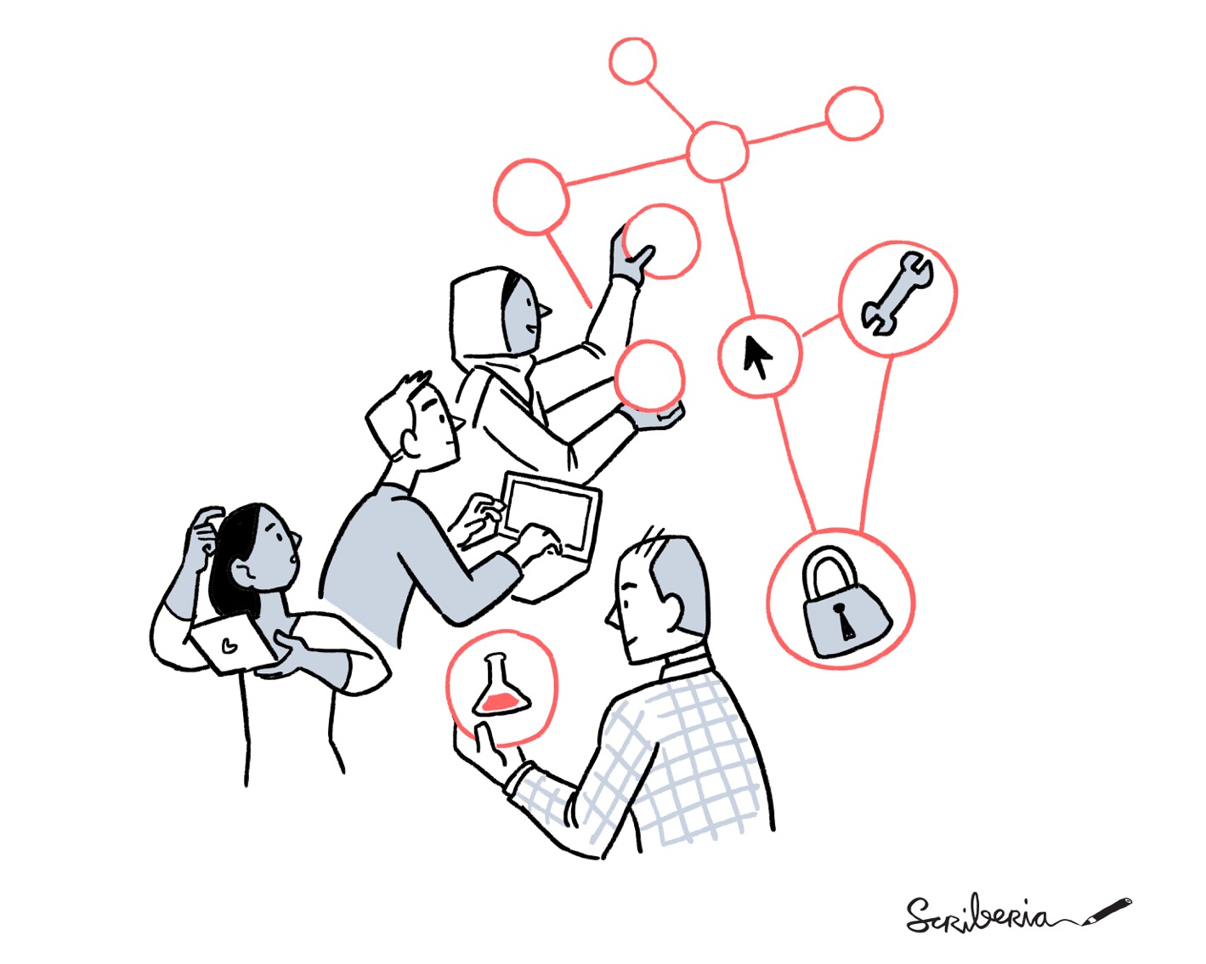
Episode 3: Problem Solving
This image was created by Scriberia for The Turing Way community and is used under CC-BY licence. http://doi.org/10.5281/zenodo.4323154
Notes:
Introduction:
"In this section, we’ll focus on problem-solving strategies, a critical skill in both research and software development."
Importance:
"Effective problem-solving helps us tackle complex challenges systematically, ensuring our research and code are robust and reliable."
What to Expect:
"We’ll explore techniques to break down problems, plan solutions, and make decisions that support collaboration and adaptability."

Slide 38
Activity: Exercise (15 minutes)
Sam wants to train a model to predict whether someone has a certain medical condition - they have clinical data, including diagnoses of the condition. Sam is collaborating with Charlie, and they have a high-level chat about the project, discussing what they would like to get out of the model. Sam is keen to get started so fires up the computer and begins writing code. After some time, Charlie asks Sam to share the uncertainties of the current model predictions - Sam does not have this information. Together, Sam and Charlie make changes to the code. To enable uncertainties to be calculated, they end up having to rewrite a significant amount of the code. Following this, they are stuck with what to do next.
Notes:
in this example, Sam starts coding before fully understanding what the model needs to do. Later, this causes issues when Charlie requests uncertainty estimates, requiring them to rewrite the code. Let’s discuss what went wrong and how they can fix it.
What could Sam and Charlie have done differently to avoid this situation?
How does this scenario relate to challenges you’ve faced in your own projects?
Do you think they spent enough time planning?
How might tools like user stories or Agile help in this situation?”

Slide 39
Problem Solving - Fundamentals
Write down the requirements
It is unlikely we will be able to determine all the requirements upfront.
The user requirements (i.e. what users expect) can inform the solution requirements (i.e. characteristics of the software).
It is advised functional requirements (i.e. what the software should do) and non-functional requirements (i.e. how the software should behave) are considered.
Notes:
Start with Requirements:
"The first step in solving any problem is to write down the requirements clearly and comprehensively."
Evolving Understanding:
"It’s unlikely you’ll know all the requirements upfront, but capturing what you do know provides a solid starting point."
User vs. Solution Requirements:
"Distinguish between user requirements—what users expect—and solution requirements, which define the technical characteristics of the software."
Functional and Non-Functional Requirements:
"Consider both functional requirements, describing what the software should do, and non-functional requirements, which cover how the software should behave, such as performance, security, or scalability."
Wrap-Up:
"Defining requirements early helps ensure your solution aligns with user needs while accommodating technical constraints."

Slide 40
Problem Solving - Fundamentals
Break the problem down into smaller tasks (or components)
Large problems are disproportionately harder to solve than small problems.
The components should be as independent from each other as possible (i.e. should not depend on the details of each other unnecessarily).
We should make use of our requirements as they inform what needs to be done.
Notes:
Why Break Problems Down?
"Large problems can feel overwhelming and are much harder to solve than smaller, manageable pieces."
Divide and Conquer:
"Breaking a problem into smaller tasks or components makes it easier to focus on specific parts, reducing complexity."
Independent Components:
"Each component should be as independent as possible, minimizing unnecessary dependencies and simplifying implementation."
Link to Requirements:
"Let your defined requirements guide this breakdown, ensuring each task addresses a specific need or functionality."
Wrap-Up:
"A systematic breakdown helps create a clear roadmap, making the problem-solving process more structured and efficient."

Slide 41
Problem Solving - Fundamentals
Medical Condition Model
Break the problem down into smaller tasks (or components)
Data Processing
Large problems are disproportionately harder to solve than small problems.
The components should be as independent from each other as possible (i.e. should not depend on the details of each other unnecessarily).
We should make use of our requirements as they inform what needs to be done.
Training/Validation/
Test Set Extraction
Model Training
Model Prediction
Results Analysis/
Interpretation
Model Tuning
Notes:
Breaking Down the Model:
"Here, we’ve broken down the 'Medical Condition Model' into distinct components such as Data Processing, Model Training, and Results Analysis."
Step-by-Step Tasks:
"Each task—like training/validation set extraction or model prediction—focuses on a specific, manageable aspect of the problem."
Independence of Components:
"Notice how each component can largely function independently. For example, data processing doesn’t need to rely on model training details, reducing complexity."
Guided by Requirements:
"These components are guided by the requirements we defined earlier, ensuring each piece addresses a key part of the project."
Iterative Refinement:
"Breaking the problem into these pieces also allows for iterative refinement, where you can improve one part without disrupting others."
Wrap-Up:
"This structured breakdown not only simplifies development but also makes debugging and collaboration much easier."

Slide 42
Problem Solving - Fundamentals
Plan the overarching structure of the codebase/system to be created
Each component should be considered a “black box” – the specific implementation details are not to be decided on at this stage.
The focus should be on what the inputs and outputs of each component will be, and how the different components will interact with one another through relatively simple mechanisms.
Different components could be implemented by different people.
Notes:
High-Level Planning:
"Before diving into coding, it's crucial to plan the overarching structure of the system or codebase."
Black Box Approach:
"Each component should be treated as a 'black box,' focusing only on its inputs and outputs, without worrying about implementation details at this stage."
Simplify Interactions:
"Design interactions between components using simple, well-defined mechanisms, ensuring they can work together seamlessly."
Enable Collaboration:
"This approach allows different components to be developed independently, making it easier to collaborate or divide work among team members."
Wrap-Up:
"By focusing on high-level structure and defining clear interfaces, you create a flexible, scalable system that is easier to implement and maintain."

Slide 43
Problem Solving - Fundamentals
Plan the overarching structure of the codebase/system to be created
Each component should be considered a “black box” – the specific implementation details are not to be decided on at this stage.
The focus should be on what the inputs and outputs of each component will be, and how the different components will interact with one another through relatively simple mechanisms.
Different components could be implemented by different people.
Unified Modelling Language (UML)
Object-Oriented Programming (OOP)
Notes:
Tools for structuring!!
Unified Modelling Language (UML):
"UML is a visual tool to design and plan your system. It helps you represent components, their relationships, and interactions in a clear, standardized way."
Object-Oriented Programming (OOP):
"OOP organizes your code into objects that encapsulate both data and behaviors. This aligns well with the 'black box' approach, making components modular and reusable."
Connection to Planning:
"Using tools like UML and approaches like OOP ensures your codebase is well-structured and components interact smoothly while staying independent."
Wrap-Up:
"These tools and techniques are especially helpful for visualizing and implementing complex systems, ensuring clarity and collaboration."

Slide 44
Problem Solving - Fundamentals
Identify the easiest representation of the data to work with
A poor choice can significantly increase the complexity and/or decrease the performance of the code we end up writing.
Think about the operations to be performed and whether a specific data structure can facilitate efficiently.
(describes the way in which a collection of data items is organised and stored)
Notes:
Importance of Data Representation:
"Choosing the right way to represent your data is critical, as a poor choice can increase complexity and reduce performance."
Focus on Operations:
"Think about the operations you need to perform on the data and select a structure that facilitates those efficiently."
Data Structures:
"A data structure determines how a collection of data items is organized and stored, impacting how easily and quickly you can manipulate it."
Impact on Code:
"The right data representation simplifies your code and makes it more robust, while the wrong one can lead to inefficiencies and unnecessary challenges."
Wrap-Up:
"Investing time upfront in selecting the easiest and most appropriate data representation can save significant effort during development."

Slide 45
Problem Solving - Fundamentals
Decide on the tools and technologies needed
To do so, we can ask the following questions:
What are the most suited?
What are we already comfortable using?
What will promote reusability?
What will aid development?
Notes:
Importance of Tool Selection:
"Choosing the right tools and technologies is essential to streamline development and ensure project success."
Guiding Questions:
"Ask yourself: What tools are most suited to the task? What are you already comfortable using? What will promote reusability, and what will aid in development?"
Balancing Needs and Comfort:
"While it’s important to leverage familiar tools for efficiency, don’t hesitate to adopt new ones if they are better suited for the problem."
Long-Term Considerations:
"Consider tools and technologies that not only solve the immediate problem but also support future scalability, collaboration, and maintenance."
Wrap-Up:
"Deliberate tool selection can significantly improve productivity and ensure your project is equipped for success."

Slide 46
Problem Solving - Fundamentals
Design for potential change and sharing with others
It is important we take time upfront to design our software to be easily modifiable and extendable.
Implementing quick and easy solutions can result in our software becoming messy and complex.
Good code should do what was intended while being readable, understandable and not overly complicated.
With practice, it will become easier to follow “best practices” and assess how much time and effort we should put into doing so.
Notes:
Plan for Flexibility:
"Invest time upfront to design software that is modifiable and extendable, ensuring it can adapt to future needs."
Avoid Quick Fixes:
"While quick solutions may seem tempting, they often lead to messy, complex code that is hard to maintain."
Good Code Characteristics:
"Good code is not only functional but also readable, understandable, and avoids unnecessary complexity."
Follow Best Practices:
"With practice, adhering to best practices becomes easier, helping you balance the effort needed to create robust and maintainable software."
Sharing-Friendly Design:
"Designing for sharing ensures your code is accessible to others, enabling collaboration and future reuse."
Wrap-Up:
"Thoughtful design upfront saves time and effort in the long run, making your software easier to maintain, extend, and share."

Slide 47
Problem Solving - Fundamentals
Often two heads are better than one
Taking time to discuss our problem with a colleague or collaborator can prove invaluable.
If collaborating in an official capacity, it can be useful to agree on terminology and programming conventions.
It is often best to avoid having a single person as the sole knowledge holder of a codebase.
Notes:
Value of Collaboration:
"Collaboration allows you to leverage different perspectives and expertise, often leading to better solutions."
Discuss and Share:
"Taking time to discuss the problem with a colleague or collaborator can help uncover new approaches or identify overlooked details."
Set Standards:
"If working as a team, agree on shared terminology and programming conventions to maintain consistency and clarity."
Avoid Knowledge Silos:
"Ensure that no single person holds all the knowledge about a codebase, as this can create risks for maintenance and continuity."
Wrap-Up:
"By working together and sharing knowledge, you create a more resilient and effective development process."

Slide 48
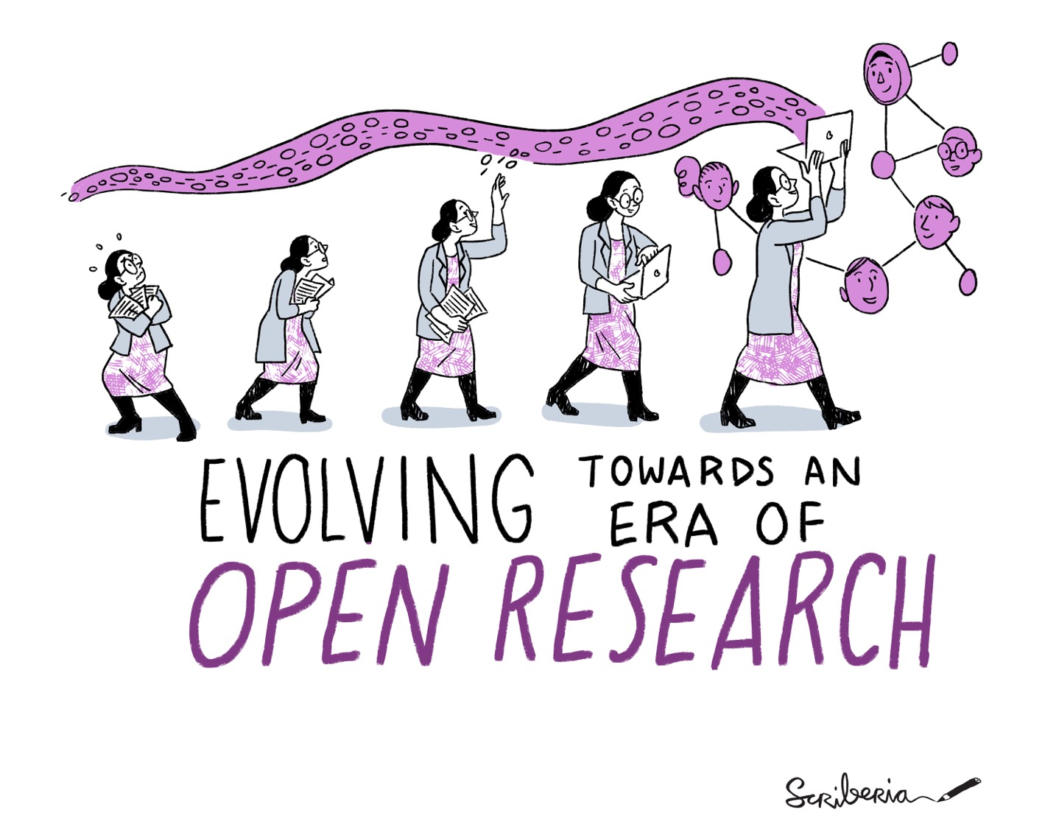
Episode 4: Virtual Environments & Dependency Managers
This image was created by Scriberia for The Turing Way community and is used under CC-BY licence. http://doi.org/10.5281/zenodo.4323154
Notes:
Key Talking Points:
Introduction:
"In this section, we’ll explore virtual environments and dependency managers—essential tools for managing project dependencies and ensuring reproducibility."
Why It Matters:
"Managing dependencies effectively helps avoid conflicts between projects and ensures that your code runs consistently across different systems."
What to Expect:
"We’ll discuss how virtual environments isolate dependencies for specific projects and how dependency managers help track and maintain those dependencies."

Slide 49
Virtual Environments & Dependency Managers
The vast majority of code written requires external libraries that provide certain functionalities, sometimes even specific versions of them are needed.
A dependency manager enables us to specify the versions of each dependency we need and installs these dependencies for us.
A virtual environment can be used to isolate dependencies for a specific project, making it easier to develop, run, test and share code.
 | Python | R
Example Dependency | matplotlib | ggplot2
Dependency Manager | pip | install.packages()
Virtual Environment Library | venv | renv
Notes:
Why Dependencies Matter:
"Most code relies on external libraries for specific functionalities, and sometimes exact versions of these libraries are required."
Role of Dependency Managers:
"Dependency managers allow you to specify the versions of libraries your project needs and handle installing and updating them for you."
Benefits of Virtual Environments:
"Virtual environments isolate dependencies for each project, ensuring there are no conflicts between projects and making your code easier to develop, test, and share."
Wrap-Up:
"Using virtual environments and dependency managers ensures your projects are reproducible, portable, and maintainable."

Slide 50
Virtual Environments & Dependency Managers
By managing the dependencies of our projects, we can:
ensure each project has exactly the dependencies it needs and no more.
keep track of each project’s required dependencies, along with their versions, ensuring code can be run by others on their own machines, promoting reproducibility.
prevent conflicts between projects which may require different versions of the same dependency.
Notes:
Precision:
"Managing dependencies ensures each project has exactly what it needs—no more, no less—keeping the environment clean and efficient."
Reproducibility:
"By tracking dependencies and their versions, we ensure others can run the code on their own machines, promoting reproducibility."
Conflict Prevention:
"Proper dependency management prevents conflicts, especially when different projects require different versions of the same library."
Wrap-Up:
"Effective dependency management streamlines development, ensures consistent results, and avoids the headaches of version conflicts."

Slide 51
Virtual Environments & Dependency Managers
Creating a virtual environment
We need to open our terminal or command prompt and navigate to our project’s directory.
A new virtual environment can be created by running:
name

Slide 52

Virtual Environments & Dependency Managers
Creating a virtual environment
We need to open our terminal or command prompt and navigate to our project’s directory.
A new virtual environment can be created by running:
Activating a virtual environment
To activate our virtual environment, (from our project’s directory) we can run:
name
change bin to Scripts on Windows

Slide 53
Virtual Environments & Dependency Managers
Creating a virtual environment
We need to open our terminal or command prompt and navigate to our project’s directory.
A new virtual environment can be created by running:
Activating a virtual environment
To activate our virtual environment, (from our project’s directory) we can run:
name
change bin to Scripts on Windows

Slide 54
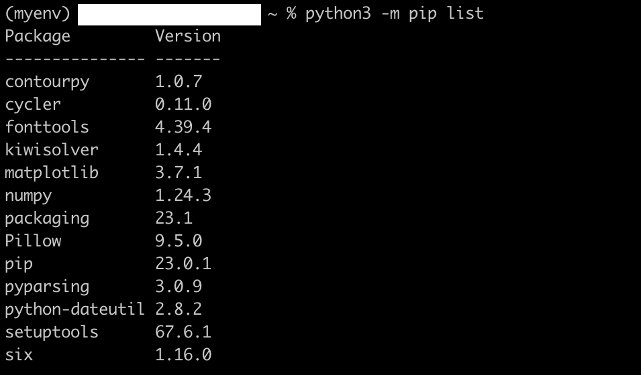
Virtual Environments & Dependency Managers
Installing dependencies
We can install a dependency in our (activated) virtual environment by running:
add ==3.7.0 to install version 3.7.0
use uninstall to later remove this dependency

Slide 55
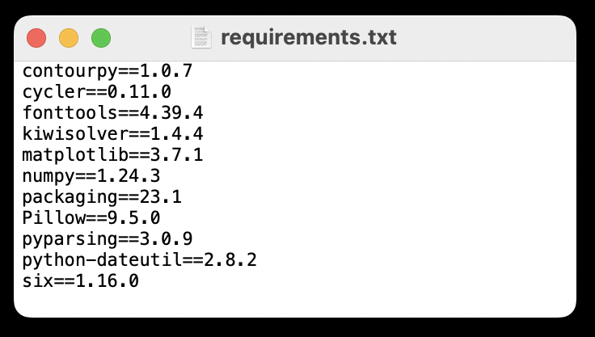

Virtual Environments & Dependency Managers
Creating a requirements.txt file
We can share our virtual environment with others by creating a requirements.txt file, which lists all the dependencies installed with their versions.
*
* Git Logo by Jason Long is licensed under the Creative Commons Attribution 3.0 Unported License

Slide 56
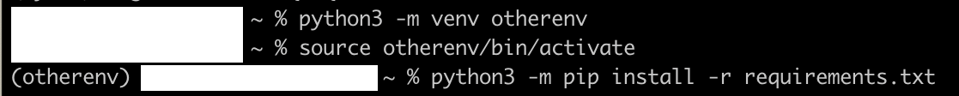
Virtual Environments & Dependency Managers
Creating a requirements.txt file
We can share our virtual environment with others by creating a requirements.txt file, which lists all the dependencies installed with their versions.
*
* Git Logo by Jason Long is licensed under the Creative Commons Attribution 3.0 Unported License

Slide 57
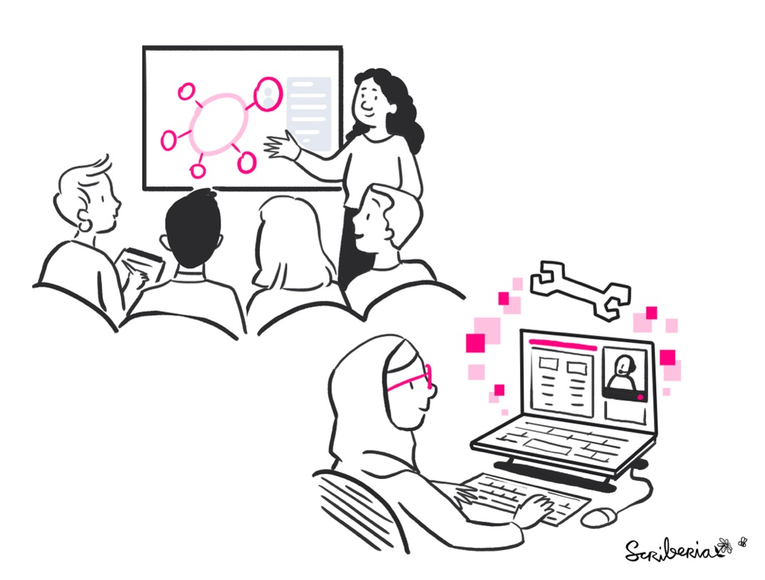
venv Demo
This image was created by Scriberia for The Turing Way community and is used under CC-BY licence. http://doi.org/10.5281/zenodo.7587336

Slide 58

Acknowledgements
*
Content was adapted from…
Intermediate Research Software Development, The Carpentries Incubator (CC-BY 4.0)
Manifesto for Agile Software Development
Agile delivery, GOV.UK Service Manual (Open Government Licence v3.0)
Research Data Management @ University of Exeter
The Turing Way (Copyright © The Turing Way Community) (CC-BY licence)
Decomposition & Style, Nick Parlante, Stanford University
OpenDSA Data Structures and Algorithms Modules Collection (MIT License)
Developed by Dr Fliss Guest with the help of Dr Thomas Hawes, Mr Linus Tata and Dr Matt Johns.
* This image was created by Scriberia for The Turing Way community and is used under CC-BY licence. http://doi.org/10.5281/zenodo.3695300

Slide 59

Course Leader:
Course Helpers:
Post-workshop Anonymous Feedback Form 2024-25
Thank You
https://tinyurl.com/2d8fys7e
Notes:
N.B. Slack link only works if a participant downloads Slack first. All links will be circulated after the workshop for those who prefer an email link.

