Slide 1
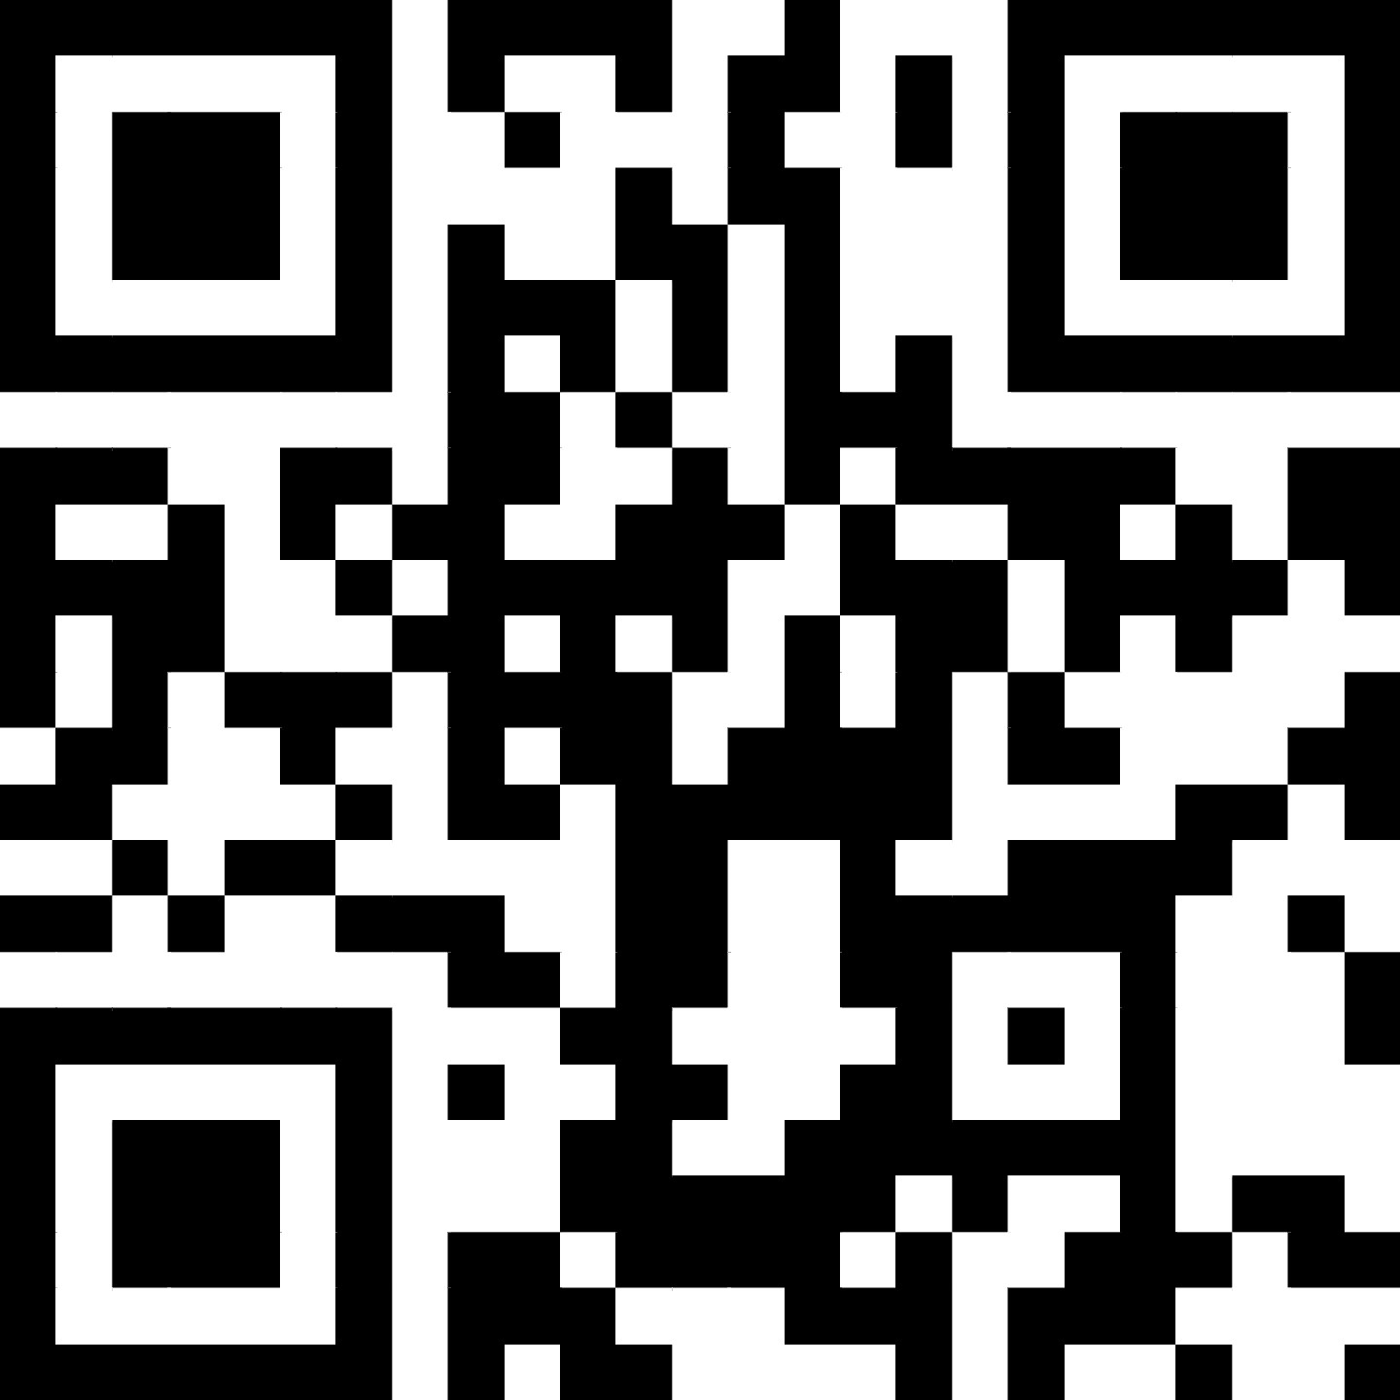
Software Development Best Practice Coding for Reproducible Research
Course Leader:
Course Helpers:
Sign in here
December 2024
https://tinyurl.com/8f9pwf4k

Slide 2


This image was created by Scriberia for The Turing Way community and is used under CC-BY licence. http://doi.org/10.5281/zenodo.3695300
Notes:
Key Talking Points:
1. Warm Welcome:
• “Welcome back, everyone! I hope you found the first session useful and are ready to build on what we covered.”
2. Recap of Last Week:
• “Last week, we explored the Software Development Life Cycle, Data Management, Problem Solving, and Virtual Environments & Dependency Managers.”
3. What’s Ahead:
• “Today, we’ll dive into Version Control, Readable Code & Documentation, Testing, and Collaboration & Reproducibility.”
4. Interactive Session:
• “As always, feel free to ask questions and engage in the activities—we’re here to learn together.”
5. Quick Check:
• “Does anyone have any lingering questions or reflections from last week before we jump in?”

Slide 3
Course Objectives
On completion of this course, we will:
have a high-level understanding of software development for research.
be able to collaborate on code effectively.
be able to improve the reproducibility of our research by understanding how to make our code useful to others.
have the necessary foundations for intermediate level courses that will delve deeper into software development topics.
Notes:
Key Talking Points:
1. Reminder of Our Goals:
• “Let’s quickly revisit our overarching goals for this course.”
2. High-Level Understanding:
• “By the end, you’ll have a solid understanding of software development practices tailored for research.”
3. Collaboration Skills:
• “You’ll know how to collaborate effectively on code, a critical skill for team-based projects.”
4. Reproducibility Focus:
• “We’re emphasizing reproducibility—making your research code useful to others and easier to replicate.”
5. Foundation for Growth:
• “This course lays the groundwork for exploring more advanced software development topics in the future.”

Slide 4
Session Topics
Last Week:
Software Development Life Cycle & Methodologies
Data Management
Problem Solving
Virtual Environments & Dependency Managers
Today:
Version Control
Readable Code & Documentation
Testing
Collaboration & Reproducibility
Notes:
Key Talking Points:
1. Quick Recap:
• “Last week, we covered foundational topics like the Software Development Life Cycle, Data Management, Problem Solving, and Virtual Environments.”
2. Today’s Focus:
• “Today, we’ll move forward with practical and collaborative skills: Version Control, Readable Code & Documentation, Testing, and Collaboration & Reproducibility.”

Slide 5
Session Topics
Any questions?
Last Week:
Software Development Life Cycle & Methodologies
Data Management
Problem Solving
Virtual Environments & Dependency Managers
Today:
Version Control
Readable Code & Documentation
Testing
Collaboration & Reproducibility
Notes:
3. Engagement:
• “These are interactive sessions, so feel free to ask questions and share your experiences as we go.”
Wrap-Up:
• “Let’s dive into our first topic for today: Version Control.”

Slide 6
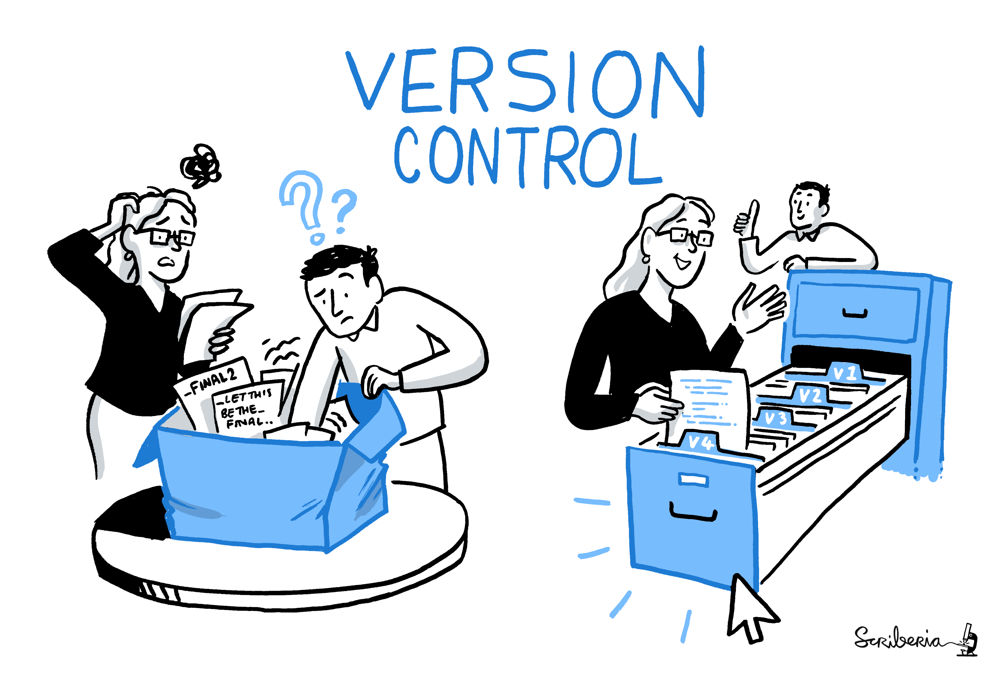
Episode 1: Version Control
This image was created by Scriberia for The Turing Way community and is used under CC-BY licence. http://doi.org/10.5281/zenodo.3695300
Notes:
Key Talking Points:
1. Introduction:
• “Our first topic today is Version Control, a foundational practice for managing changes to your code and collaborating effectively.”
2. Why It Matters:
• “Version control helps you keep track of your code’s evolution, revert to earlier versions, and collaborate seamlessly with others.”
3. What’s Ahead:
• “We’ll explore tools like Git and GitHub and discuss how they simplify project management and collaboration.”
Transition:
• “Let’s start by understanding what version control is and why it’s essential.”

Slide 7


Version Control
Version control is the process by which we record and manage the history of files.
A version control system, such as Git, can be used to capture and keep track of changes.
It enables us to view the evolution of our files and revert back to previous versions.
Git is often used in conjunction with GitHub, a web platform that facilitates collaboration.
Git
GitHub
*
* Git Logo by Jason Long is licensed under the Creative Commons Attribution 3.0 Unported License
Notes:
Key Talking Points:
1. What is Version Control?
• “Version control is a process that records and manages the history of your files, allowing you to track changes over time.”
2. Role of Systems Like Git:
• “A version control system, like Git, captures these changes and provides tools to review the evolution of your files.”
3. Benefits of Version Control:
• “It allows you to revert to previous versions, ensuring you can recover from mistakes or explore alternative ideas.”
4. Git and GitHub:
• “Git is often paired with GitHub, a web platform that not only stores your Git repositories but also facilitates collaboration and project management.”
Wrap-Up:
• “Version control is a game-changer for managing your work and collaborating effectively, especially in research projects.”

Slide 8
Version Control
Using Git and GitHub, we can:
revert back to a previous version of a file (or files) at any time.
easily share our code, and collaborate on it, with others.
reduce the effort required to keep a good, orderly record of development and combine our work with others’.
utilise project management tools (via GitHub).
Notes:
Key Talking Points:
1. Revert Changes:
• “Git allows you to revert to a previous version of any file or set of files, giving you the confidence to experiment without fear of losing progress.”
2. Share and Collaborate:
• “GitHub makes it easy to share your code with others, enabling seamless collaboration on projects.”
3. Orderly Record Keeping:
• “By using Git, you can maintain a clear and organized history of your development process, making it easier to track progress and review changes.”
4. Project Management Tools:
• “GitHub also offers powerful tools like issues, project boards, and pull requests, which help with task tracking, progress monitoring, and code reviews.”
Wrap-Up:
• “Together, Git and GitHub are invaluable for managing both your code and your projects effectively.”

Slide 9

Version Control Demo
This image was created by Scriberia for The Turing Way community and is used under CC-BY licence. http://doi.org/10.5281/zenodo.7587336
Notes:
Key Talking Points:
1. What to Expect:
• “In this demo, we’ll walk through the basics of using Git and GitHub.”
2. Focus Areas:
• “We’ll cover initializing a repository, making commits, and pushing changes to GitHub.”
• “You’ll also see how to use branches for feature development and pull requests for collaboration.”
3. Interactive Opportunity:
• “Feel free to ask questions or note down areas you’d like clarified as we go through the demo.”
Wrap-Up:
• “Let’s dive in and see how version control works in practice!”

Slide 10
Version Control - Demo
Steps | Commands
1. Create a repository on GitHub.
2. Clone the repository to our machine. | git clone web-URL
3. Navigate to the local copy of the repository. | cd repo-name
4. Modify the README.md file.
5. Check the status of the repository. | git status
6. Add the changes. | git add README.md
7. Commit the changes. | git commit –m ‘add description to `README.md`’
8. Push the changes to the remote repository. | git push
9. View the changes on GitHub.
Notes:
Key Talking Points:
1. Step-by-Step Hands-On Guide:
• “For this demo, we’ll go through a practical example of setting up and using Git and GitHub.”
2. Steps We’ll Cover:
• “First, we’ll create a repository on GitHub.”
• “Then, we’ll clone it to our local machine using git clone.”
• “Next, we’ll navigate to the local copy with cd and make a small change to the README.md file.”
• “After that, we’ll check the status of the repository using git status.”
3. Staging and Committing Changes:
• “We’ll add the changes with git add README.md and commit them using git commit -m with a message describing the update.”
4. Pushing Changes:
• “We’ll push the changes to the remote repository using git push.”
5. View Results:
• “Finally, we’ll view the changes on GitHub to confirm everything worked as expected.”
Wrap-Up:
• “This process demonstrates the core workflow of Git and GitHub—how to make changes locally and sync them to a remote repository.”

Slide 11
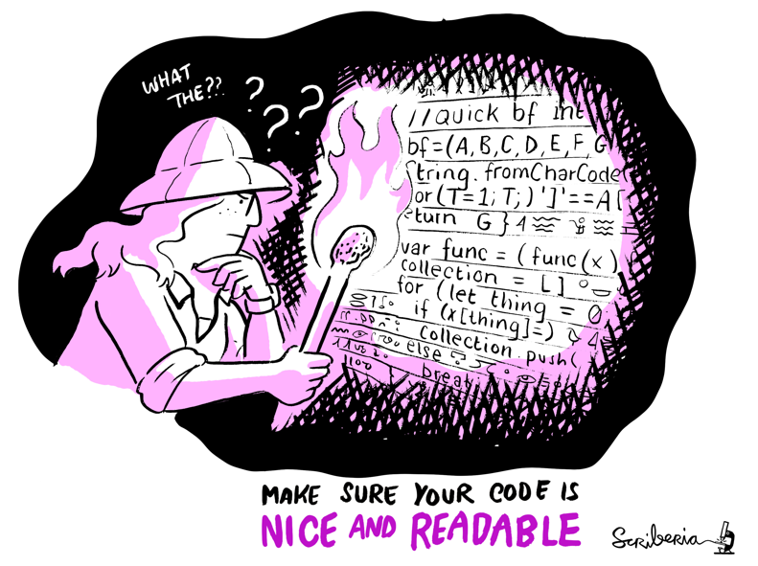
Episode 2: Readable Code & Documentation
This image was created by Scriberia for The Turing Way community and is used under CC-BY licence. http://doi.org/10.5281/zenodo.3695300
Notes:
Key Talking Points:
1. Introduction:
• “Our next topic is Readable Code and Documentation, which are critical for ensuring your code is understandable, maintainable, and usable by others.”
2. Why It’s Important:
• “Readable code reduces errors, simplifies adding new features, and makes it easier for others to build on your work.”
• “Clear documentation complements this by explaining how your code works and why certain decisions were made.”
3. What to Expect:
• “We’ll discuss strategies for improving code readability, maintaining consistency, and creating meaningful documentation.”
Transition to Exercise:
• “To start this section, we’ll jump into a quick exercise to explore the importance of readable code.”

Slide 12
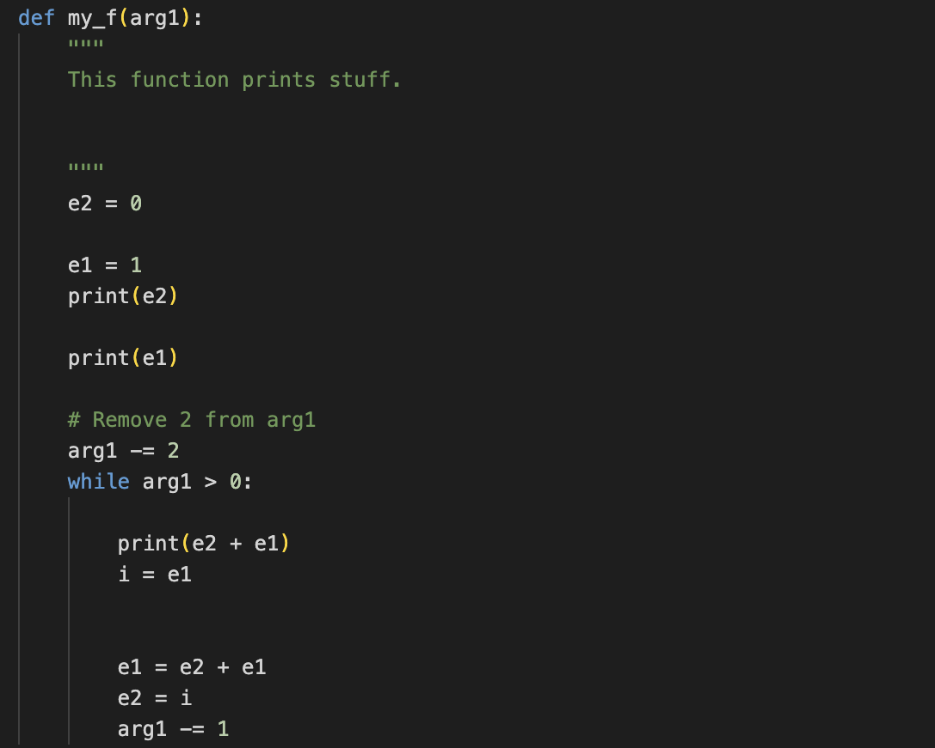
Activity: Exercise (10 minutes)
This Python code prints the Fibonacci sequence (0, 1, 1, 2, 3, 5, 8, …) up to the required sequence length.
What makes this code difficult to read and/or understand? How could we improve it?
Notes:
Exercise Overview:
• “You’ll be reviewing a piece of Python code that prints the Fibonacci sequence up to a specified length.”
• “The task is to identify what makes the code difficult to read or understand and think about how it could be improved.”
3. Why This Matters:
• “This exercise will help you see firsthand how readability impacts the ability to debug, extend, and share code.”
4. Instructions:
• “Take 10 minutes to analyze the code. Note down your observations about its readability and your ideas for improvement.”
Wrap-Up:
• “Once you’re done, we’ll discuss your thoughts and solutions as a group.”
Open the Discussion:
• “Alright, time’s up! Let’s hear your thoughts. What made this code difficult to read or understand?”
• “Does anyone want to share their ideas on how it could be improved?”
• Prompt Specific Areas (if needed):
• “What did you think about the variable names? Were they clear?”
• “Did the structure of the code make sense, or was it confusing?”

Slide 13
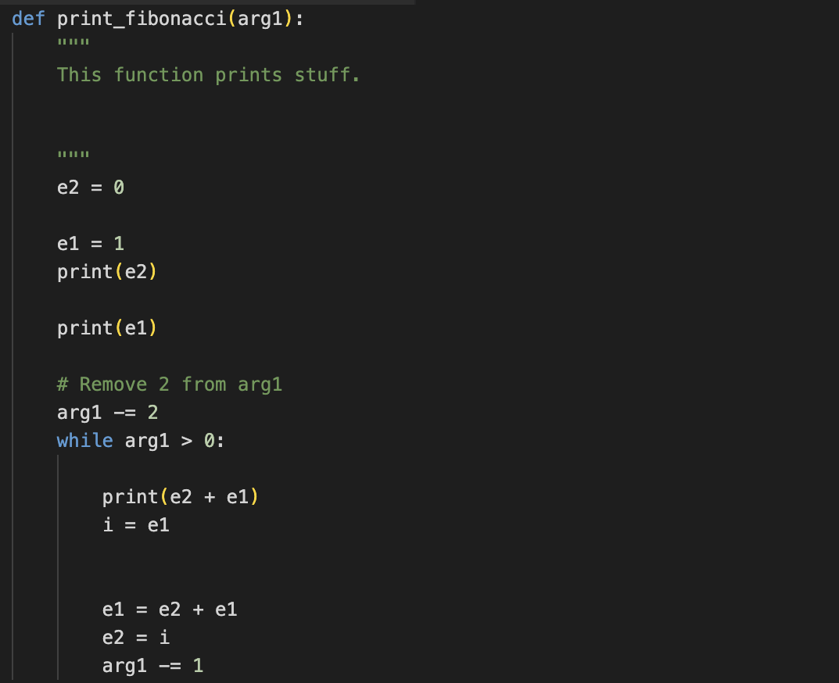
Activity: Exercise (Solution)
1. Change the name of the function – it should succinctly tell us what the function does.

Slide 14
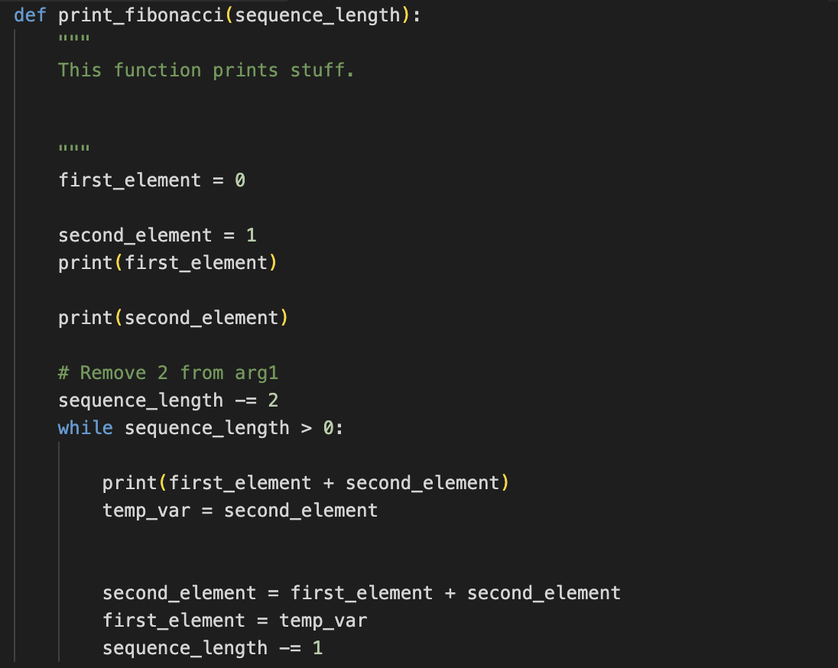
Activity: Exercise (Solution)
2. Change the variable names – they should clearly and concisely describe what the variables represent.

Slide 15
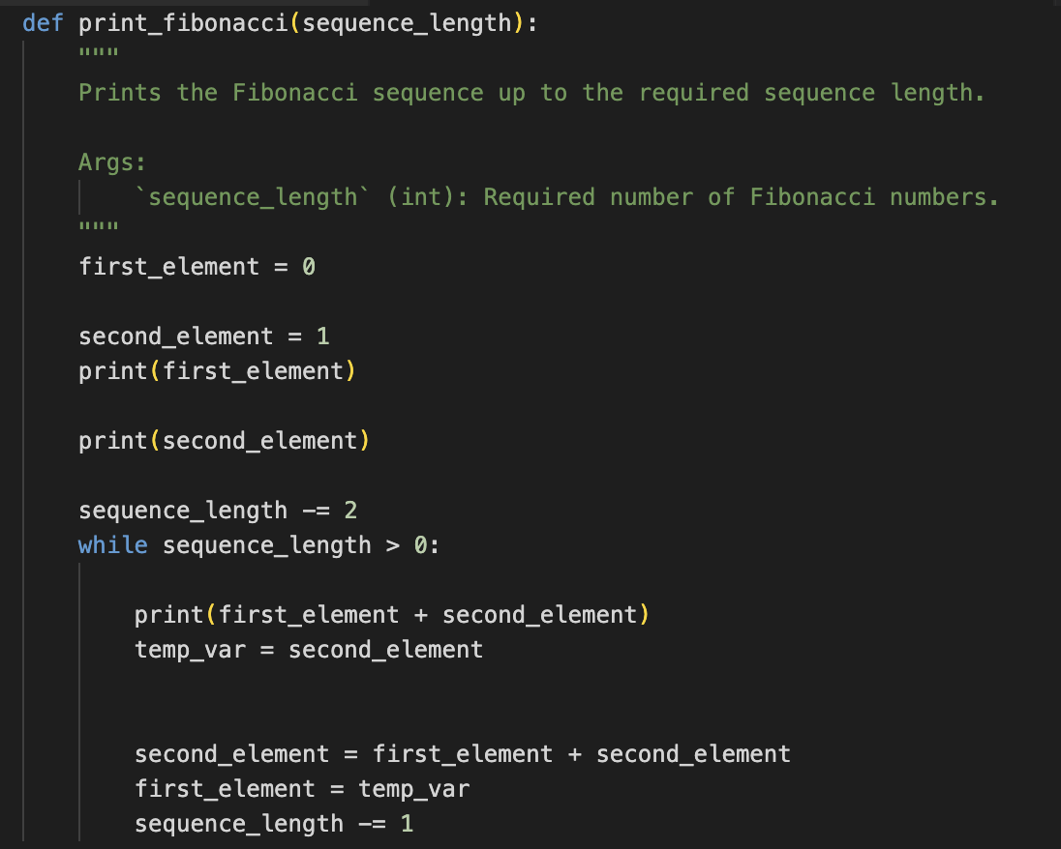
Activity: Exercise (Solution)
3. Improve the documentation – a useful explanation of the function should be provided and comments must not simply repeat the code.

Slide 16
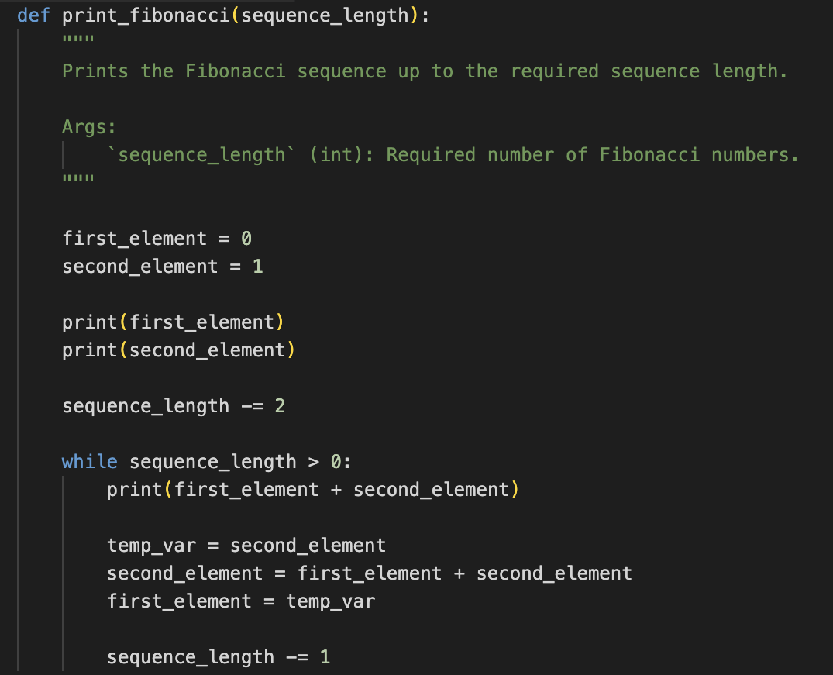
Activity: Exercise (Solution)
4. Ensure consistent use of whitespace – it can be used to separate (and emphasise) code blocks (i.e. closely related statements).

Slide 17
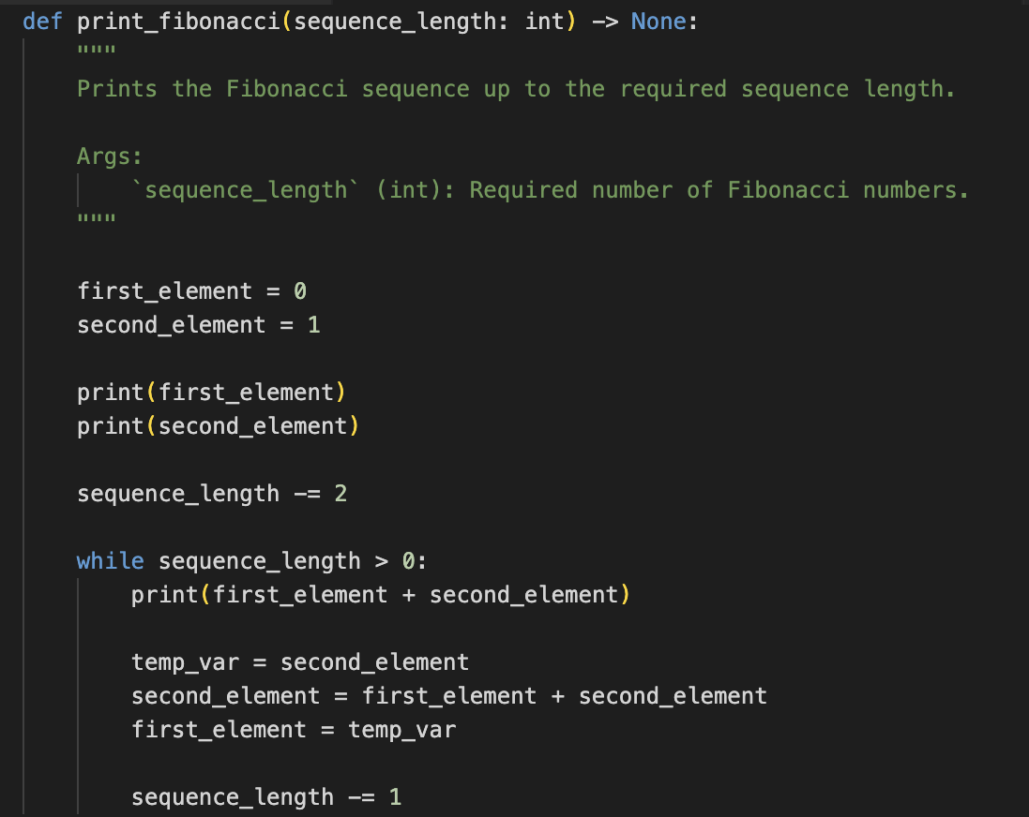
Activity: Exercise (Solution)
5. Add type hints – a relatively recent addition to Python that enables us to indicate the expected types of what the function takes in and returns.

Slide 18
Readable Code
Readable code is code that clearly communicates its intention to the reader – the reader can easily follow what it does.
Ensuring our code is readable is important because:
bugs in our code and/or errors in our methodology can become easier to identify.
adding new functionality should become simpler.
revisiting our code in the future is likely to require much less effort.
other researchers can continue to use, fix and develop our code.
other researchers can reproduce, replicate and/or extend our research more easily.
Notes:
Key Talking Points:
1. What is Readable Code?
• “Readable code is code that clearly communicates its purpose and functionality to the reader, making it easy to follow and understand.”
2. Why It’s Important:
• “Readable code helps us quickly identify and fix bugs or errors in our methodology.”
• “It makes adding new functionality simpler by reducing the cognitive load when understanding existing code.”
3. Future-Proofing:
• “Readable code is easier to revisit and modify, saving time and effort in the long run.”
4. Collaborative Benefits:
• “It ensures other researchers can use, fix, and develop the code further, promoting collaboration and reuse.”
• “Readable code facilitates reproducibility, replication, and extension of research, which are key to scientific progress.”
Wrap-Up:
• “Readable code not only benefits you but also the broader research community, ensuring your work has a lasting impact.”

Slide 19
Readable Code – Improving Readability
Ensure it is well-structured
A single component should have a single responsibility and should not depend on the details of another component unnecessarily.
It can be advantageous to avoid excessive nesting.
It can also be advantageous to avoid repetition.
DRY = Don’t Repeat Yourself
Notes:
Key Talking Points:
1. Well-Structured Code:
• “Readable code starts with good structure. Each component should have a single responsibility and operate independently of the details of other components whenever possible.”
2. Avoid Excessive Nesting:
• “Deeply nested code can become difficult to follow. Simplifying or refactoring nested structures can significantly improve readability.”
3. Minimize Repetition:
• “Repetition increases the likelihood of errors and makes code harder to maintain. Following the DRY principle—‘Don’t Repeat Yourself’—helps to create concise, maintainable code.”
Wrap-Up:
• “By focusing on structure, minimizing nesting, and avoiding repetition, you make your code easier to understand, debug, and extend.”

Slide 20
Readable Code – Improving Readability
Establish consistency
A consistent code style helps to reduce the reader’s cognitive load.
Using logical naming conventions, ensures the reader understands what a function does or a variable represents.
Employing (vertical) whitespace to separate code blocks can significantly improve readability.
Restricting the length of lines also improves readability.
It can be useful to find a style guide for our language of choice and make use of a code formatter.
Notes:
Key Talking Points:
1. Why Consistency Matters:
• “A consistent code style reduces the reader’s cognitive load, making it easier to understand and follow your code.”
2. Logical Naming Conventions:
• “Clear and logical names for functions and variables help readers immediately grasp their purpose and role in the code.”
3. Whitespace for Readability:
• “Using vertical whitespace to separate code blocks improves visual clarity and helps emphasize logical sections of your code.”
4. Line Length:
• “Restricting line length ensures the code remains easy to read without requiring horizontal scrolling.”
5. Leverage Tools:
• “Find a style guide for your programming language and use tools like code formatters to enforce consistency automatically.”
Wrap-Up:
• “Consistency in style and structure makes your code more accessible to others and easier to maintain over time.”

Slide 21
Readable Code – Improving Readability
Provide clear documentation
In-code documentation should be clear, concise and constructive.
Succinct explanations of the functionality provided by components should be present.
Comments should not simply repeat the code but clarify the more complicated aspects, along with why certain design decisions have been made (where necessary).
Notes:
Key Talking Points:
1. In-Code Documentation:
• “Good in-code documentation is clear, concise, and constructive, helping others (and yourself) understand the purpose and behavior of your code.”
2. Explain Functionality:
• “Include succinct explanations for the functionality of components, making it clear what each part of the code is supposed to do.”
3. Meaningful Comments:
• “Comments should add value by clarifying complex parts of the code or explaining design decisions. Avoid simply restating what the code itself already says.”
Wrap-Up:
• “Clear documentation ensures that your code is not just functional but also approachable, enabling others to use, adapt, and extend it effectively.”

Slide 22
Documentation
Documentation influences how easy-to-use, extendable, and by extension how sustainable, a piece of software is.
It can also simply help us to understand our own code again in the future.
Notes:
Key Talking Points:
1. Impact of Documentation:
• “Documentation is crucial for making software easy to use, extendable, and ultimately sustainable over time.”
2. A Personal Benefit:
• “It’s not just for others—clear documentation helps you understand your own code when you revisit it in the future.”
3. Essential for Collaboration:
• “Good documentation bridges the gap between developers, ensuring continuity and facilitating collaboration on the project.”
Wrap-Up:
• “Investing in documentation enhances both the usability of your software and its long-term value to the research community.”

Slide 23
Documentation
Documentation influences how easy-to-use, extendable, and by extension how sustainable, a piece of software is.
It can also simply help us to understand our own code again in the future.
Conceptual Documentation
Hands-on Documentation
Reference Documentation
Notes:
Key Talking Points:
1. Why Documentation Matters:
• “Documentation is key to making software easy-to-use, extendable, and sustainable, benefiting both you and future users.”
2. Personal Advantage:
• “It’s also a helpful tool for understanding your own code when you come back to it after some time.”
3. Types of Documentation:
• Conceptual Documentation:
• “Provides the big-picture context, explaining the purpose, scope, and key concepts of the software.”
• Hands-on Documentation:
• “Includes tutorials, walkthroughs, and examples that help users learn how to use the software effectively.”
• Reference Documentation:
• “Offers detailed information about individual components, like functions, APIs, or classes, for advanced users.”
Wrap-Up:
• “Each type of documentation serves a unique purpose and together they make software more approachable, useful, and maintainable.”

Slide 24
Documentation
Documentation influences how easy-to-use, extendable, and by extension how sustainable, a piece of software is.
It can also simply help us to understand our own code again in the future.
Conceptual Documentation
Hands-on Documentation
Reference Documentation
Notes:
Key Talking Points:
1. Combining Documentation Types:
• “When we combine conceptual, hands-on, and reference documentation, we create a comprehensive resource for users and developers.”
2. Why the Combination Matters:
• “Each type addresses different needs—conceptual documentation provides context, hands-on documentation shows how to use the software, and reference documentation gives detailed technical specifics.”
3. Impact:
well-documented software is easier to understand, use, and extend, benefiting a wider audience.”
4. The Goal:
• “Our goal is to make software not just usable but sustainable, ensuring it has a long-term impact and supports a broader community.”
Wrap-Up:
• “Effective documentation ensures your software can reach and benefit more people, turning it into a powerful tool for collaboration and innovation.”

Slide 25
Documentation
It is important to think about what documentation we will produce early.
It can be useful to think about our motivation for the documentation.
Knowing our audience can also help us determine the types of documentation we want to create.
Notes:
Key Talking Points:
1. Start Early:
• “Planning your documentation early in the project ensures it evolves alongside your code and meets the needs of its users.”
2. Understand Your Motivation:
• “Consider why you’re creating documentation—what purpose will it serve? Is it for internal team use, external collaboration, or reproducibility?”
3. Know Your Audience:
• “Identifying your audience is key. Are they developers, researchers, or non-technical users? This will determine the types and level of detail your documentation requires.”
Wrap-Up:
• “Thoughtful planning ensures your documentation is purposeful, effective, and aligned with the needs of its users.”

Slide 26
Documentation
It is important to think about what documentation we will produce early.
It can be useful to think about our motivation for the documentation.
Knowing our audience can also help us determine the types of documentation we want to create.
Three questions can kick-start this decision-making process:
Who is it for?
What do they want?
How (else) could we communicate with them?
Notes:
Key Talking Points:
1. Kick-Starting the Process:
• “When planning documentation, asking the right questions upfront can save time and ensure you produce meaningful content.”
2. Who is it for?
• “Identify your audience. Are they developers, end-users, or collaborators? Knowing who will use the documentation helps shape its tone and detail.”
3. What do they want?
• “Understand their needs. Do they require a high-level overview, step-by-step instructions, or technical details?”
4. How (else) could we communicate with them?
• “Think beyond documentation. Would additional formats like tutorials, diagrams, or videos help convey information effectively?”
Wrap-Up:
• “Answering these questions provides clarity and direction, ensuring your documentation is targeted and impactful.”

Slide 27
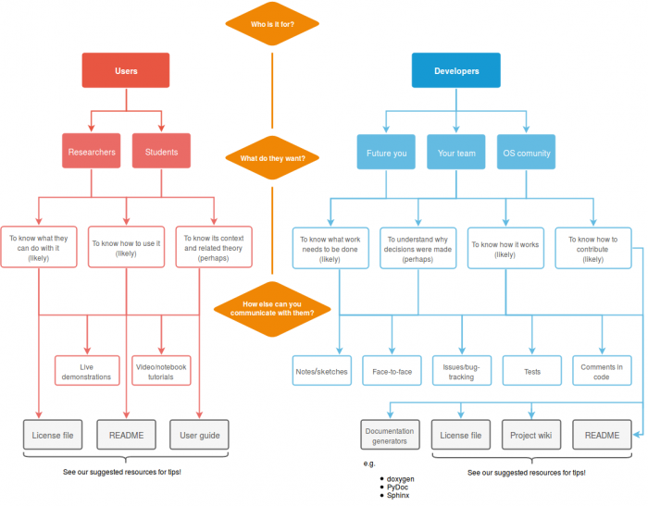
Documentation
Software Sustainability Institute (CC BY-NC 2.5 SCOTLAND)
Notes:
Key Talking Points:
1. Understanding the Audience:
• “This diagram highlights the importance of tailoring your documentation to your audience, whether they are users or developers.”
2. For Users:
• “Users, such as researchers or students, typically want to know what they can do with the software, how to use it, or its theoretical context.”
• “Appropriate documentation includes license files, READMEs, user guides, or even live demonstrations and video tutorials.”
3. For Developers:
• “Developers—whether it’s your future self, your team, or the open-source community—need to understand how the software works, why decisions were made, and how to contribute.”
• “Useful tools include documentation generators, bug tracking systems, project wikis, and in-code comments.”
4. Different Needs, Different Formats:
• “The flow emphasizes how different audiences require different types of documentation, which should be planned and delivered effectively.”
5. Comprehensive Approach:
• “Combining these elements ensures your software is both usable and maintainable, benefiting users and contributors alike.”
Wrap-Up:
• “By identifying your audience and addressing their needs, you can create documentation that truly adds value and fosters collaboration.”

Slide 28
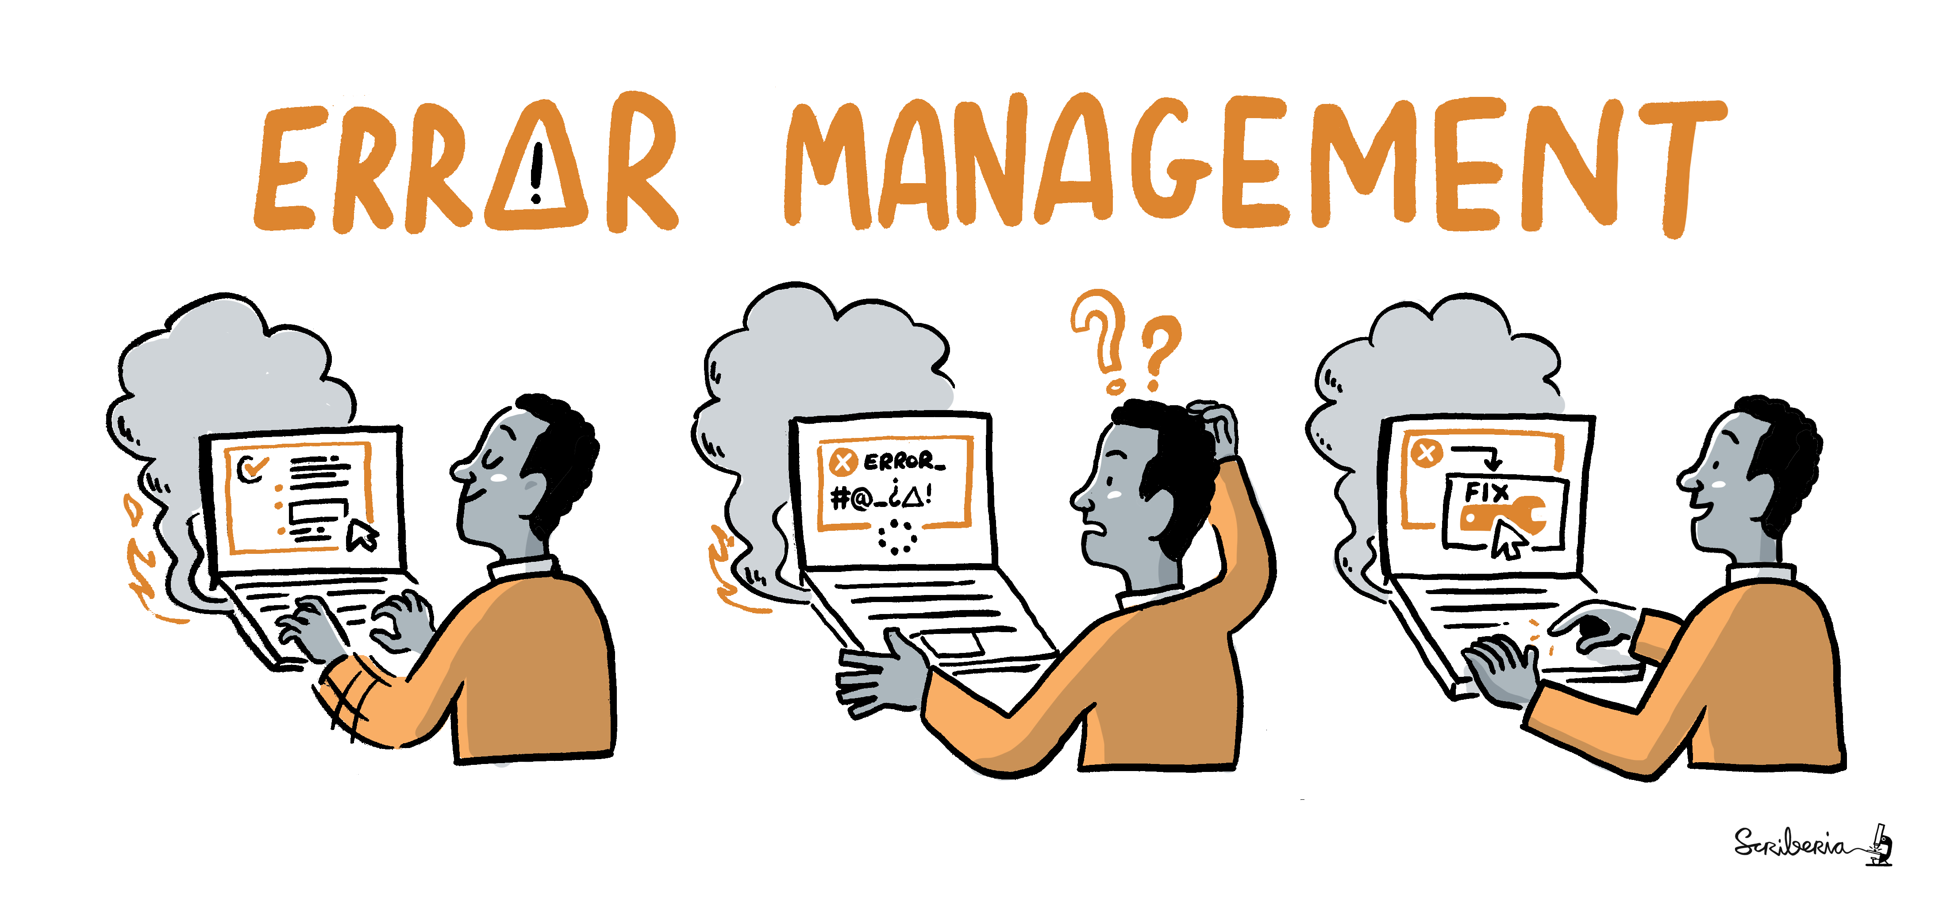
Episode 3: Testing
This image was created by Scriberia for The Turing Way community and is used under CC-BY licence. http://doi.org/10.5281/zenodo.3695300
Notes:
Key Talking Points:
1. Introduction:
• “Our next topic is Testing, a crucial practice for ensuring the reliability and correctness of your code.”
2. Why It Matters:
• “Testing helps verify that your code does what it’s supposed to do, reducing errors and ensuring accurate results in your research.”
3. What We’ll Cover:
• “We’ll explore the benefits of testing, the different types of tests, and how they can improve the quality and reproducibility of your work.”
Transition:
• “Let’s start by understanding the importance of testing and the value it brings to your projects.”

Slide 29
Testing
Testing (thoroughly and frequently) enables us to verify our code is doing what it is supposed to do.
If there are mistakes in our code, the results of our research may be partly or entirely unreliable.
Additional Benefits:
It can save time.
Formal tests can be run at any time, as well as independently and automatically.
It can improve the quality of our code.
Notes:
Key Talking Points:
1. Why Testing Matters:
• “Testing, when done thoroughly and frequently, ensures that our code behaves as expected and meets its intended purpose.”
2. Impact on Research:
• “Mistakes in code can compromise the reliability of research results, making testing a critical step in ensuring accuracy.”
3. Additional Benefits:
• Time-Saving: “While testing requires effort upfront, it saves time in the long run by catching issues early.”
• Reusability: “Formal tests can be run repeatedly and automatically, ensuring consistency as code evolves.”
• Quality Improvement: “Testing leads to cleaner, more robust code, which is easier to maintain and extend.”
Wrap-Up:
• “By integrating testing into your workflow, you not only ensure reliability but also improve the overall quality and sustainability of your software.”

Slide 30
Testing – Unit Testing
The individual units of our software are tested in an isolated and highly targeted manner, ensuring each unit works as intended/designed.
A unit is the smallest testable part of any software.
We can verify the individual components of our code are correct.
More than one test is typically written for each unit.
Each unit test should have a single focus.
Notes:
Key Talking Points:
1. What is Unit Testing?
• “Unit testing focuses on testing the smallest testable parts of a program, known as ‘units,’ in isolation.”
2. Verification:
• “These tests help verify that individual components of your code work correctly as intended or designed.”
3. Multiple Tests for Each Unit:
• “Typically, more than one test is written for each unit to ensure it handles various scenarios and edge cases.”
4. Single Focus:
• “Each unit test should target a specific functionality, keeping it simple and precise.”
Wrap-Up:
• “Unit testing helps ensure each piece of your software is reliable, making it easier to integrate into the larger system with confidence.”

Slide 31
Testing – Integration Testing
Individual units of our software are combined and tested as a whole, enabling any faults to be exposed in the interactions between them.
Integration tests ensure the components cooperate when interfacing with one another.
All units could be tested in one go or units could be tested in stages.
Integration tests are particularly important when working on code with others.
It is highly recommended unit tests are written and run prior to integration tests.
Notes:
Key Talking Points:
1. What is Integration Testing?
• “Integration testing combines individual units of software and tests them as a whole to identify any faults in the interactions between components.”
2. Purpose:
• “These tests ensure that different components cooperate correctly when interfacing with each other.”
3. Testing Approaches:
• “All units can be tested together in one go, or the process can be done in stages, depending on the complexity of the system.”
4. Importance in Collaboration:
• “Integration testing is particularly crucial when working with a team, as it verifies that all contributions work together as intended.”
5. Unit Tests First:
• “It’s highly recommended to write and run unit tests before performing integration tests, ensuring the individual components are reliable.”
Wrap-Up:
• “Integration testing bridges the gap between individual components and the overall system, ensuring a cohesive and functional software application.”

Slide 32
Activity: Discussion (10 minutes)
Imagine our Python function (from earlier) returns the Fibonacci sequence (0, 1, 1, 2, 3, 5, 8, …) up to the required sequence length rather than simply printing it.
How could we test this function?
Notes:
Key Talking Points:
1. Set the Scenario:
• “Imagine the Python function we discussed earlier now returns the Fibonacci sequence as a list, up to a specified length, instead of simply printing it.”
2. Task Overview:
• “The goal is to discuss how we could test this function. Think about different scenarios, edge cases, and what needs to be verified.”
3. Guiding Questions:
• “What inputs would you use to test the function?”
• “What outputs would you expect for those inputs?”
• “How could you test edge cases, like a sequence length of 0 or 1?”
4. Encourage Collaboration:
• “Feel free to work in pairs or groups, and take notes on your ideas.”
5. Purpose:
• “This exercise is about understanding how to approach testing systematically, ensuring your code works as expected in all scenarios.”
Wrap-Up:
• “After 10 minutes, we’ll come back together to discuss your ideas and explore possible solutions.”
1. Test Basic Functionality
• Input: Sequence length = 5
Expected Output: [0, 1, 1, 2, 3]
• Verify the function generates the correct Fibonacci sequence for a typical input.
• Input: Sequence length = 10
Expected Output: [0, 1, 1, 2, 3, 5, 8, 13, 21, 34]
• Check for correctness with a longer sequence.
2. Test Edge Cases
• Input: Sequence length = 0
Expected Output: []
• Ensure the function handles an empty sequence appropriately.
• Input: Sequence length = 1
Expected Output: [0]
• Confirm the function handles a single-element sequence correctly.
3. Test Invalid Inputs
• Input: Sequence length = -1
Expected Output: Error or exception (depending on design)
• Verify the function rejects invalid inputs gracefully.
• Input: Sequence length = "five" (non-integer input)
Expected Output: Error or exception
• Ensure the function handles incorrect data types appropriately.
4. Performance Testing
• Input: Sequence length = 1000
• Confirm the function runs efficiently for large sequences without errors or performance bottlenecks.
5. Consistency and Correctness
• Compare the function’s output with precomputed Fibonacci sequences for various inputs to ensure correctness across multiple test cases.

Slide 33
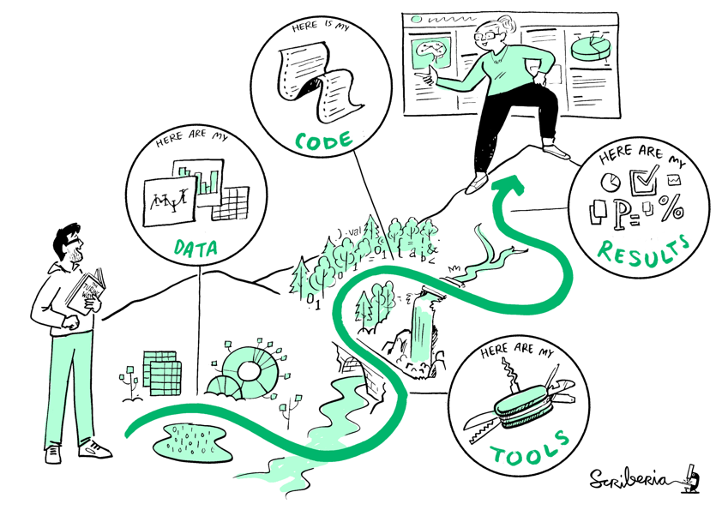
Episode 4: Collaboration & Reproducibility
This image was created by Scriberia for The Turing Way community and is used under CC-BY licence. http://doi.org/10.5281/zenodo.3695300
Notes:
Key Talking Points:
1. Introduction:
• “In this final section, we’ll discuss Collaboration and Reproducibility—two essential pillars of modern research software development.”
2. Why It Matters:
• “Collaboration enables teams to work together effectively, while reproducibility ensures that research can be verified, trusted, and extended by others.”
3. What We’ll Cover:
• “We’ll explore practices, tools, and strategies that support collaborative workflows and reproducible research.”
4. Relevance to Research:
• “By adopting these principles, we make our work more impactful and accessible to the wider community.”
Transition:
• “Let’s start by understanding why collaboration and reproducibility are so critical in research settings.”

Slide 34
Collaboration – Case Study
The project brings together a number of organisations with the primary aim of developing a complex system to enable further research in a particular area.
Notes:
What to Say:
• “This case study represents a collaborative project involving multiple organizations working together to develop a complex system that supports further research.”
• “Collaboration in such a context brings both opportunities and challenges.”
• Engagement:
• Ask: “Have you worked on a project involving multiple organizations? What was your experience like?”

Slide 35
Collaboration – Case Study
The project brings together a number of organisations with the primary aim of developing a complex system to enable further research in a particular area.
Agile principles have been adopted and adapted.
Notes:
What to Say:
• “In this project, Agile principles have been adopted and adapted to help manage the collaboration and development process.”
• “Agile practices like iterative development, regular feedback, and flexibility help teams stay aligned while accommodating changes.”
• Engagement Prompt:
• Bit of a refresher.... “Can you think of ways Agile principles—like working in sprints or iterating on feedback—might help in research projects? How might they be adapted for academic work?”

Slide 36
Collaboration – Case Study
The project brings together a number of organisations with the primary aim of developing a complex system to enable further research in a particular area.
Git and GitHub are being used for version control and project management.
Issues – track tasks
Project Boards – monitor progress
Pull Requests – enable code review
*
* Git Logo by Jason Long is licensed under the Creative Commons Attribution 3.0 Unported License
Notes:
What to Say:
• “Git and GitHub are being used to manage version control and project collaboration. Tools like issues, project boards, and pull requests streamline workflows and foster teamwork.”
• “These tools not only track progress but also enable code reviews, which improve quality and reproducibility.”
• Engagement Prompt:
• “Can you think of a way GitHub tools like project boards or pull requests could be useful in your research or teaching workflows? How might they help you work with others?”

Slide 37
Collaboration – Case Study
The project brings together a number of organisations with the primary aim of developing a complex system to enable further research in a particular area.
Communication is fundamental and can be hard to get right.
Notes:
What to Say:
• “In collaborative projects, effective communication is fundamental but not always easy to achieve. Clear, frequent, and intentional communication is key.”
• “This project emphasizes that even with good tools and processes, communication is often the hardest part to get right.”
• Engagement Prompt:
• “What strategies can you think of to improve communication in a collaborative setting? Have you seen or used techniques like scheduled check-ins or documentation-based communication?”

Slide 38
Collaboration – Case Study
The project brings together a number of organisations with the primary aim of developing a complex system to enable further research in a particular area.
Despite having good intentions, there have inevitably been a few challenges (to date), including:
finding effective strategies for working as a seamless collective.
striking a balance between “best practices” and rapid short-term development.
Notes:
What to Say:
• “This project faced challenges like balancing best practices with rapid development and aligning the work of different organizations into a seamless process.”
• “These are common challenges in collaborative projects and underscore the need for deliberate planning and adaptation.”
• Engagement Prompt:
• “Can you think of situations where you’ve had to balance long-term quality with short-term delivery? How might best practices help, even under tight deadlines?”
Wrap-Up
• “This case study highlights how software engineering best practices—like Agile methodologies, collaborative tools, and effective communication—can help manage complex research projects.”
• “As we continue, think about how these practices might apply to your own work or studies, even in smaller-scale projects.”

Slide 39
Reproducibility
Why should we invest in reproducibility?
The credibility of our research can be improved if others are able to replicate and confirm its results.
There is evidence open access articles receive more citations.
Research within our field could potentially progress at a faster rate.
It can make it easier to identify and connect with appropriate collaborators.
Knowledge is more widely shared and research is more accessible to the public.
It could lead to an alternative metric system for research impact.
Notes:
ey Talking Points:
1. Why is Reproducibility Important?
• “Reproducibility is a cornerstone of credible research. It allows others to replicate and confirm your results, strengthening trust in your work.”
2. Citations and Impact:
• “Evidence shows that open-access articles, which promote reproducibility, often receive more citations, increasing the reach and recognition of your work.”
3. Accelerating Progress:
• “By making research reproducible, knowledge within your field can progress at a faster rate, as others can build on your work with confidence.”
4. Collaboration Opportunities:
• “Reproducibility makes it easier to connect with collaborators who share similar interests and goals.”
5. Public Accessibility:
• “Sharing reproducible research ensures knowledge is more widely distributed and accessible to the public.”
6. New Metrics for Impact:
• “Reproducibility can lead to alternative metrics for assessing research impact, focusing on accessibility and real-world contributions.”
Wrap-Up:
• “Investing in reproducibility doesn’t just enhance your work—it contributes to a stronger, more collaborative, and impactful research community.”

Slide 40
Reproducibility
The degree to which we employ reproducible practices will likely depend on the scope of the project.
To achieve openness in research, each element of the process should be:
Publicly Available
Reusable
Transparent
Notes:
Key Talking Points:
1. Scalability of Reproducibility:
• “The degree to which we apply reproducible practices will depend on the scope and nature of the project.”
• “Smaller projects may require less rigor, while larger, collaborative efforts benefit greatly from comprehensive reproducibility.”
2. Core Principles:
• “To achieve openness in research, every element of the process should follow these three principles:”
• Publicly Available:
• “Make research outputs, such as code and data, accessible to others wherever possible, respecting ethical and legal boundaries.”
• Reusable:
• “Ensure that others can build upon your work by sharing well-documented, modular, and clean outputs.”
• Transparent:
• “Be clear about your methods, decisions, and processes so others can understand and replicate your results.”
3. Why This Matters:
• “Adopting these principles not only enhances credibility but also makes collaboration more effective and accelerates scientific progress.”
Wrap-Up:
• “Openness, reusability, and transparency are the building blocks of reproducible research, driving both individual and collective success.”

Slide 41
Reproducibility
At a minimum, it is suggested we: | It is also worth considering:
consider how to promote quality assurance | dependency management
minimise manual steps | code style and structure
use open-source software | data validation and error handling
use version control software | testing (inc. continuous integration)
partake in peer review to assess adherence to reproducible principles | packaging
make any data and code accessible via sharing platforms
provide documentation
Software Engineering Practices in Academia: Promoting the 3Rs – Readability, Resilience, and Reuse
software engineering practices in the context of project scopes
Notes:
Key Talking Points:
1. Minimum Suggestions:
• “At a minimum, we should aim to:
• Promote quality assurance by reviewing and validating processes.
• Minimize manual steps to reduce human error and improve repeatability.
• Use open-source software to increase accessibility and transparency.
• Employ version control systems like Git to track changes and collaborate effectively.
• Participate in peer reviews to evaluate adherence to reproducibility principles.
• Make data and code accessible via sharing platforms.
• Provide thorough and clear documentation.”
2. Additional Considerations:
• “To go a step further, consider:
• Dependency management to ensure consistent environments.
• Adopting standardized code styles and structures.
• Implementing robust data validation and error handling.
• Including testing practices, such as continuous integration, to automate quality checks.
• Packaging your software to make it easier to share and reuse.”
3. Key Takeaway:
• “These practices build on the core principles of reproducibility and help achieve readability, resilience, and reuse in research software.”
Wrap-Up:
• “By embedding these practices into our workflows, we can ensure that our research is reliable, impactful, and accessible to others.”

Slide 42

Acknowledgements
*
Content was adapted from…
Intermediate Research Software Development, The Carpentries Incubator (CC-BY 4.0)
Manifesto for Agile Software Development
Agile delivery, GOV.UK Service Manual (Open Government Licence v3.0)
Research Data Management @ University of Exeter
The Turing Way (Copyright © The Turing Way Community) (CC-BY licence)
Decomposition & Style, Nick Parlante, Stanford University
OpenDSA Data Structures and Algorithms Modules Collection (MIT License)
Developed by Dr Fliss Guest with the help of Dr Thomas Hawes, Mr Linus Tata and Dr Matt Johns.
* This image was created by Scriberia for The Turing Way community and is used under CC-BY licence. http://doi.org/10.5281/zenodo.3695300

Slide 43
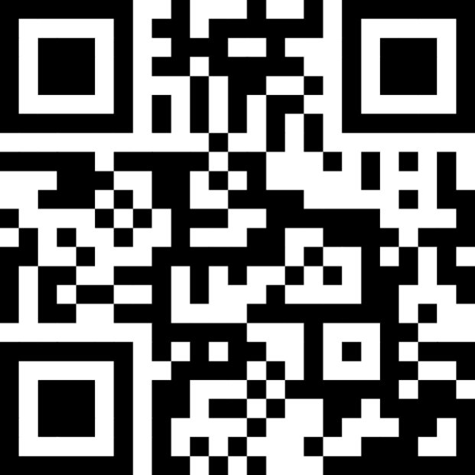
Course Leader:
Course Helpers:
Post-workshop Anonymous Feedback Form 2024-25
Thank You
https://tinyurl.com/2d8fys7e
Notes:
N.B. Slack link only works if a participant downloads Slack first. All links will be circulated after the workshop for those who prefer an email link.

